Slide 1
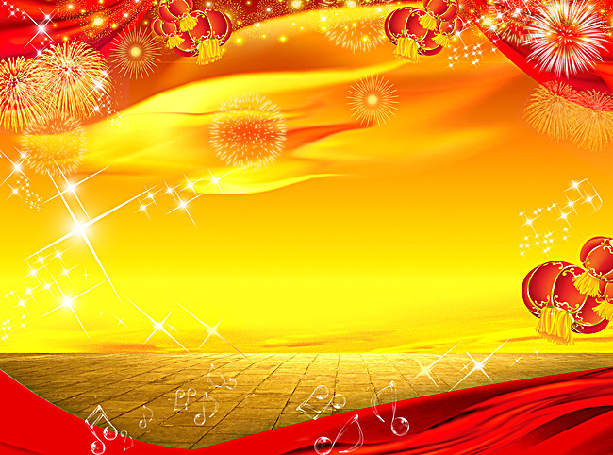
UNIT 9.
FESTIVAL AROUND THE WORLD
A CLOSER LOOK 1

Slide 2


Vocabulary
1. (to) parade (v): diễu hành
a parade: cuộc diễu hành
2. culture (n): văn hóa
=> cutural (adj): thuộc về văn hóa, có tính văn hóa
3. (to) perform (v): biểu diễn, trình diễn
performer: người trình diễn / biểu diễn
4. (to) celebrate (v): làm lễ kỉ niệm, kỉ niệm
celebration (n): lễ kỉ niệm
celebratory (adj): mang tính kỉ niệm

Slide 3




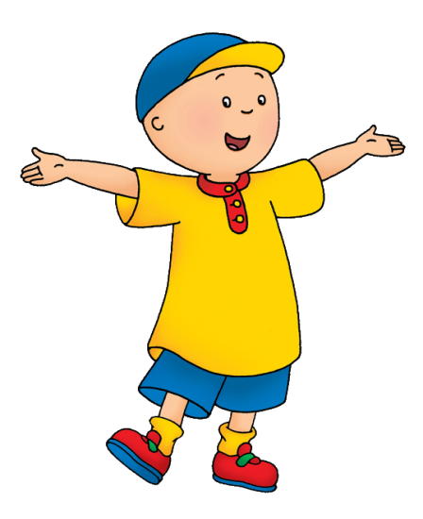
VOCABULARY
1a
Complete the table below
Verb | Noun | Adjective
celebrate | 1. | celebratory
 | festival | 2.
3. | parade
 | 4. | cultural
perform | performer 5.
celebration
festive
parade
culture
performance

Slide 4
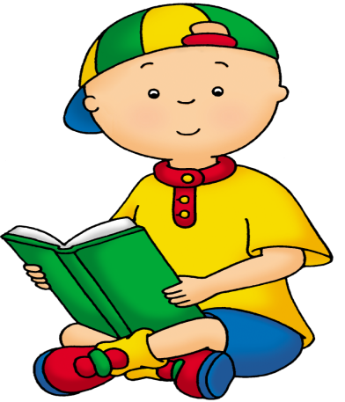

VOCABULARY
1b
Complete the sentences with the words from the table in a
1.Carnival (Carnaval in Portuguese) is a popular f _ _ _ _ _ in many countries in South America.
2.It usually happens in February, and South American people c _ _ _ _ _ _ it in different ways.
3.The Rio Carnival is the biggest and most famous, with the most lively c _ _ _ _ _ _ _ .
4.It gives people a chance to learn about the true c _ _ _ _ _ of Brazil.
5.People wear costumes and p _ _ _ _ through the streets, playing samba music and dancing.
6.The highlight of the Rio Carnival is the Samba p _ _ _ _ _ _ _ _ _ with thousands of samba performers from various samba schools.
festival
celebrate
celebrations
culture
parade
performers

Slide 5

VOCABULARY
2
In groups, choose a festival . Take turns to say the name of the festival, then add an action.
Example:
A: I am going to Rio Carnival to watch performers dance.
B: I am going to Rio Carnival to watch performers dance, and musicians play samba music.
C: I am going to Rio Carnival to watch performers dance, and musicians play samba music, and...

Slide 6
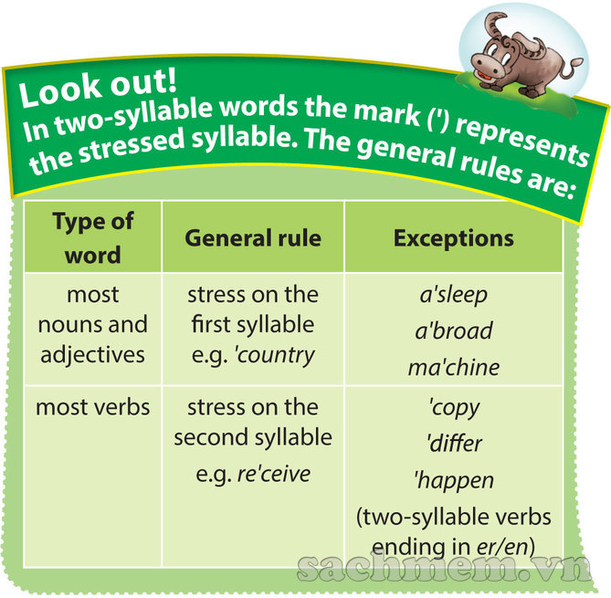
Pronunciation
Stress in two- syllable words.

Slide 7
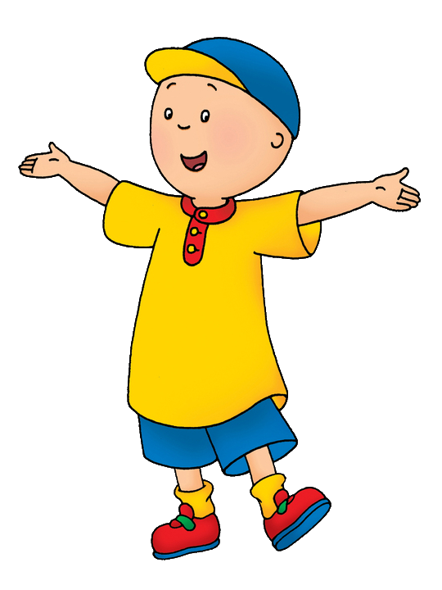

Pronunciation
3
Listen and repeat the words. Then listen again and put them into correct column according to their stress pattern.
gather
relax
gather
picture
artist
enjoy
hotel
describe
hotel
lovely
rename
famous
Stress on 1st syllable
Stress on 2nd syllable
gather
relax
picture
enjoy
artist
hotel
lovely
describe
famous
rename

Slide 8






Pronunciation
4
Circle the word with different stress pattern from the others. Then listen and check.
1.A.money B.dancer C.shopping D.balloon
2.A.common B.happy C.complete D.joyful
3.A.prepare B.enter C.answer D.listen
4.A.pumpkin B.funny C.water D.alone
5.A.tidy B.compete C.prefer D.adopt

Slide 9

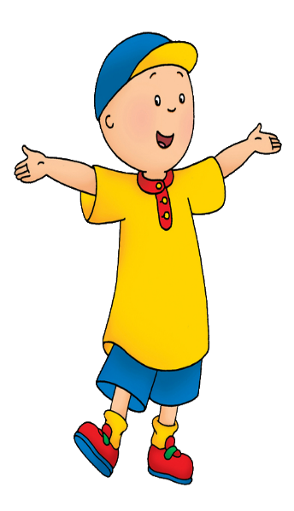
Pronunciation
5
Read the following sentences, and mark (‘) the stresses syllable in the underlined words.Then listen, check and repeat.
1.We're going to discuss our festival project.
2.A lot of dancers go to Rio de Janeiro to attend the Rio Carnival.
3.I think nobody will answer the phone because they have gone to the music festival.
'project
'dancers
'
'answer
‘music

