Slide 1
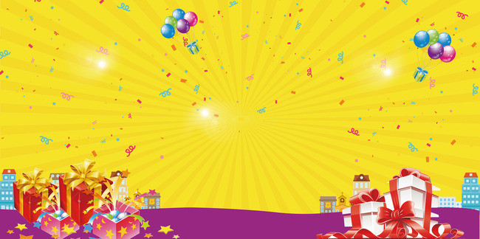
UNIT 9. FESTIVALS AROUND THE WORLD
GETTING STARTED

Slide 2



Unit 9. Festivals around the world
Getting started
Listen and read
“The festival project”

Slide 3
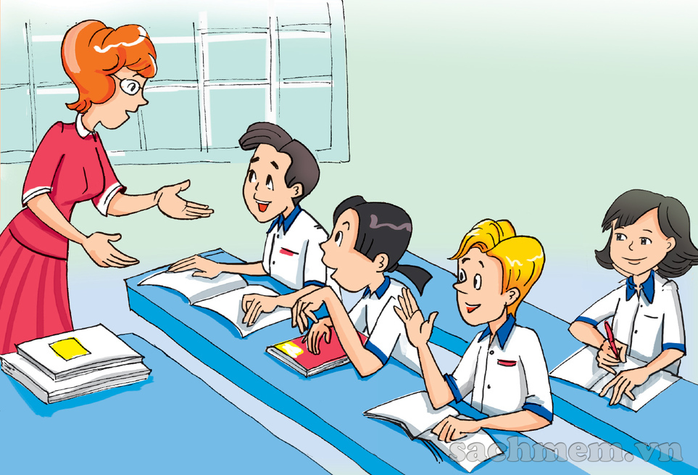
What are they talking about?
Where are they?

Slide 4



THE FESTIVAL PROJECT.
1. Listen and read.
Teacher: Which festival did you choose, Nick?
Mai: I chose Diwali. It’s an Indian festival
Teacher: Why did you choose it?
Nick: Actually, I chose a Vietnamese festival!
Mai: Well, it’s called the 'Festival of Lights’ and it’s a religious festival. I think candles are so romantic, and I love fireworks. There are lots of both during Diwali.
Teacher: Oh really? Which one did you choose?
Teacher: That’s a great choice. And you, Phong?
Nick: I chose the Elephant Race Festival in Dak Lak. I think elephants are fascinating animals! It must be amazing to see them racing.
Phong: I chose La Tomatina. It’s held in Spain, in a small town called Buñol. It’s a seasonal festival to celebrate the tomato harvest.
Teacher: What do you like about it?
Teacher: OK, that’s interesting. How about you, Mai?
Phong: For one hour, people get to throw tomatoes at each other!
Teacher: Wow! That does sound unusual. OK, finally, Mi.
Mi: I chose something a little different. It’s a music festival called Burning Man. It’s held every year at the end of August. People go to the desert, make a camp, and have a party!
Teacher: Wow, that’s a new one on me! Sounds fascinating. OK, I’d like you to write up your reports and hand them in to me by...

Slide 5
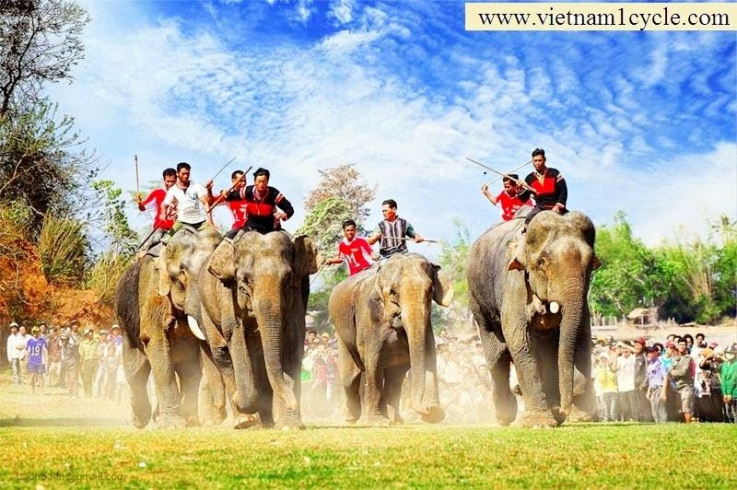
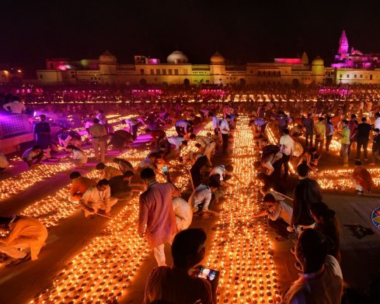
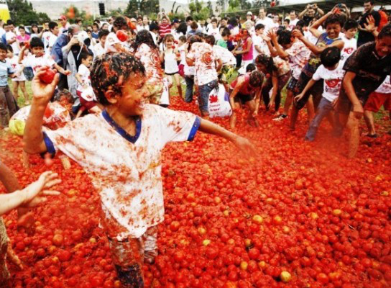
Diwali = Festival of Lights:
lễ hội ánh sáng
Elephant Race Festival: Lễ hội đua voi
La Tomatina:
Lễ hội ném cà chua

Slide 6


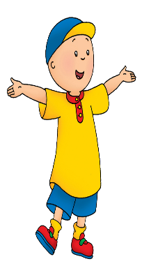

1
Listen and read. a. Answer the following questions
1.Did the teacher expect Nick to choose a Vietnamese festival? Why/ Why not?
→ No, she didn’t because she said “Oh really?” to show her surprise.
2.What do people do to celebrate Diwali?
→ People light candles and display off fireworks.
3.Which festival is held in a small town?
→ It’s La Tomatina.
4.Why does Mi think her festival is unusual?
→ Because to celebrate the festival people go to the desert, make a camp, and have a party.
5.What should the students do after this discussion with the teacher?
→ They should write up reports and hand them into the teacher.

Slide 7
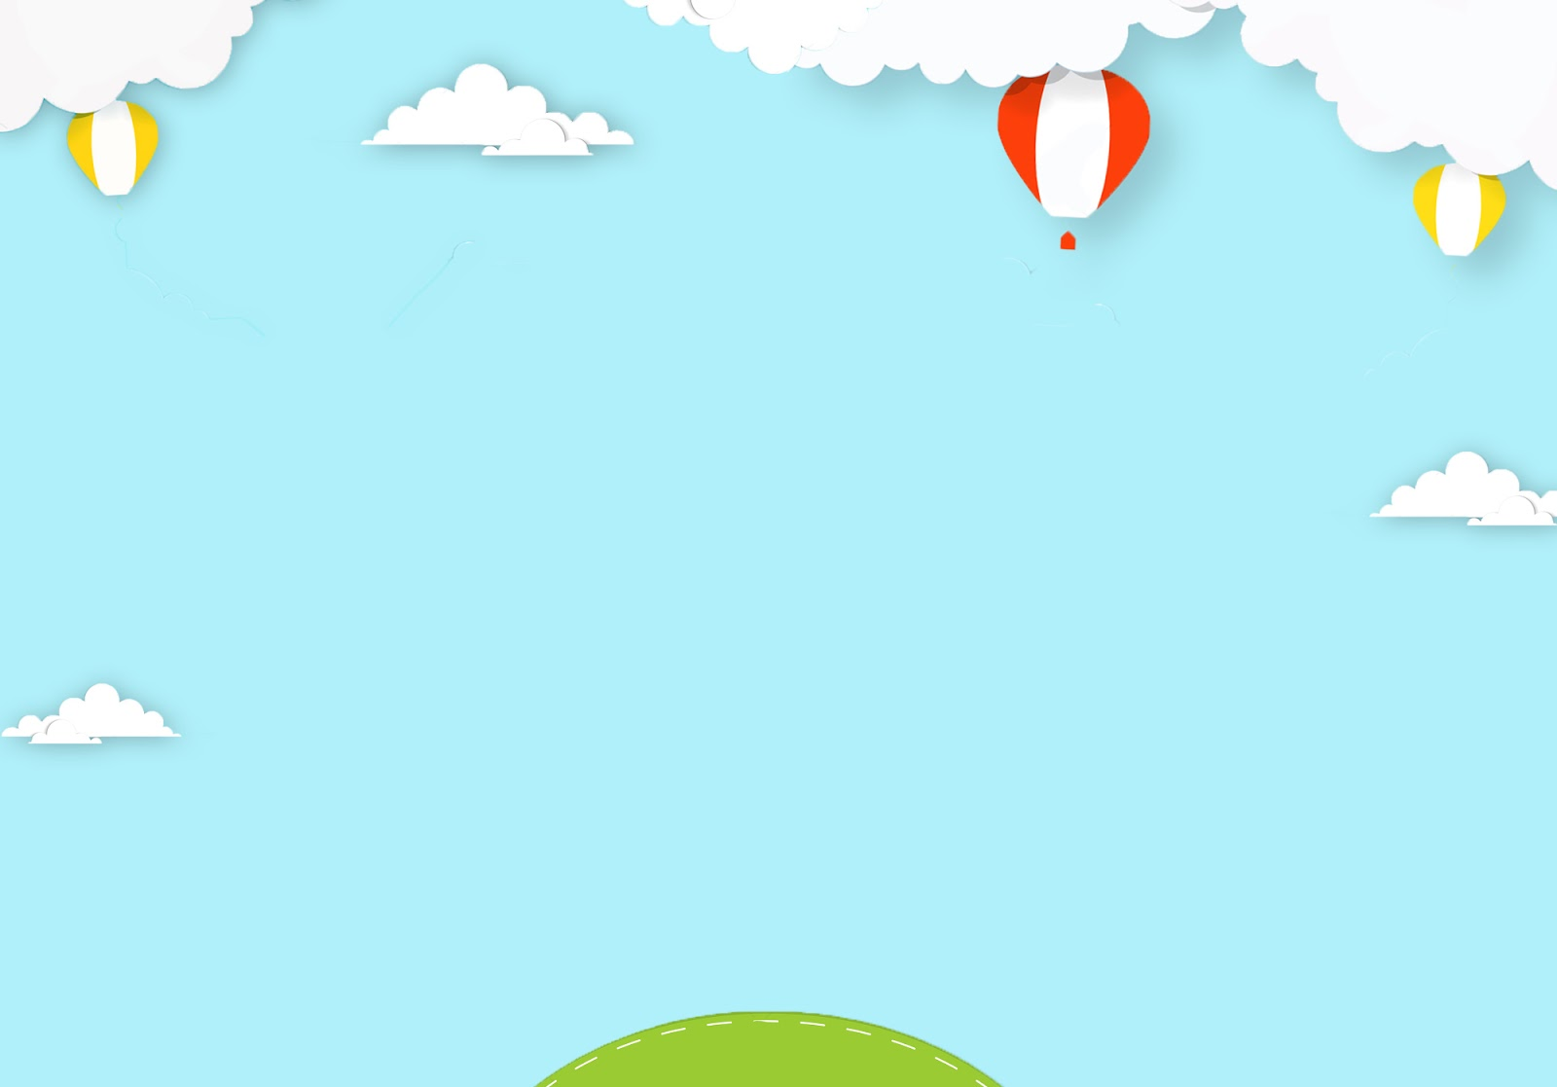



2
Read the conversation again. The tick (v) True (T) or False (F).
T
F
1.Nick chose the festival because he would like to see elephants racing.
2.The 'Festival of Lights' is another name for Diwali.
3.People throw tomatoes at each other for one day at La Tomatina.
4.Burning Man is held in the desert.

Slide 8
Vocabulary
1. religious (adj): thuộc về tôn giáo
religious festival: lễ hội tôn giáo
2. seasonal (adj): thuộc về mùa
seasonal festival: lễ hội theo mùa
3. superstitious (adj): mang tính mê tín
superstitious festival
4. music festival: lễ hội âm nhạc
5. arts festival: lễ hội nghệ thuật

Slide 9
FESTIVALS
Christmas: lễ giáng sinh
Rock in Rio: lễ hội nhạc Rock ở Rio
Water Festival: Lễ hội té nước
Easter: Lễ Phục Sinh
Cannes Film Festival: Liên hoan phim Cannes
Halloween: Lễ hội hóa trang
Ghost Day: Vu lan, còn được gọi là lễ báo hiếu
Thanksgiving: Lễ Tạ ơn
Mid – Autunm Festival : Tết trung thu

Slide 10

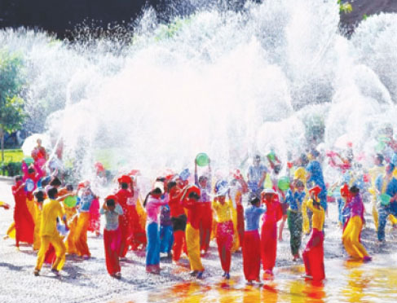

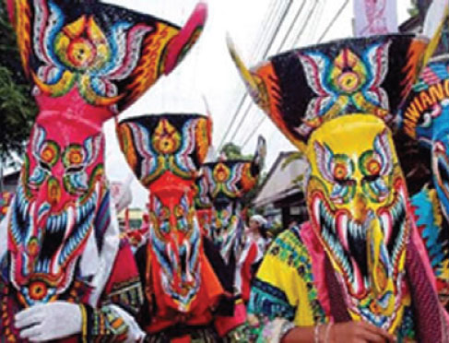
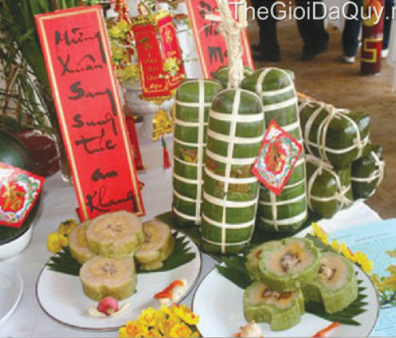
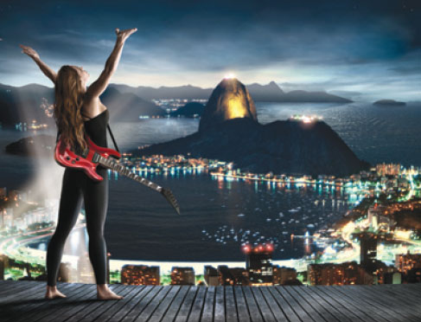
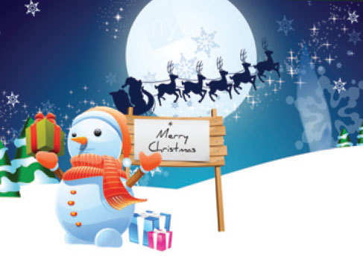
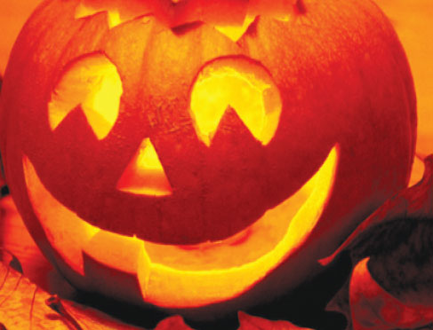
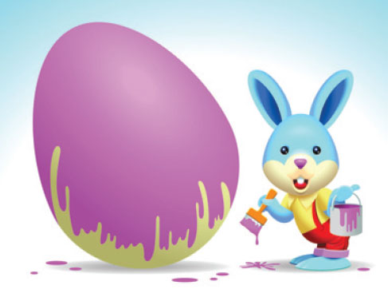
2
Write the festival in the box under the pictures. Then listen and repeat.
Tet
Easter
Christmas
Cannes Film Festival
Rock in Rio
Halloween
Water Festival
Ghost Day
Water Festival
Cannes Film Festival
Ghost Day
Tet
Rock in Rio
Christmas
Halloween
Easter

Slide 11

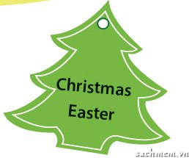

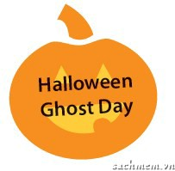
3
Match the festivals below with the reasons they are held.
religious
seasonal
music/ arts
superstitious
music/ arts
religious
seasonal
superstitious

Slide 12

4
Compare your answer with a partner
Example:
A: I think Rock in Rio and the Cannes Film Festival are music or arts festivals.
B: I agree.
A: Which do you think are seasonal festivals?
B: I think Christmas and Easter. How about you?
A: I think Halloween and Ghost Day.
A: I think …… and …… are …………….. festivals.
B: I agree/ I don’t agree.
A: Which do you think are ……………… festivals?
B: I think ……….…………
How about you?
A: I think ………………
Rock in Rio
Cannes Film Festival
music
arts
seasonal
Christmas
Easter
Halloween
Ghost Day

