Slide 1

Unit 10
our HOUSE IN THE FUTURE
COMMUNICATION

Slide 2


Activity 1
Have telephones at home
Go to school

Slide 3
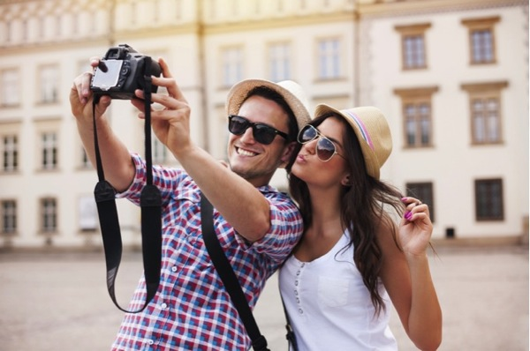

Take pictures with our cameras
Watch new films in the cinema

Slide 4


Go on holiday to the beach
Send postcards
to friends

Slide 5
Have telephones at home
Remove

Slide 6

Go on holiday to the beach
Remove

Slide 7
Take pictures with our cameras
Remove

Slide 8

Send postcards to friends
Remove

Slide 9
Watch new films in the cinema
Remove

Slide 10
Go to school
Remove

Slide 11



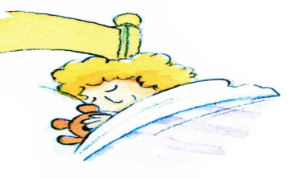



Revision
Might & will
John
Who will be here?
−> John
Who might come?
−> Sally
Sally

Slide 12

Revision
Will for the future
(-) Will not = won’t
Might for furure possibility

Slide 13



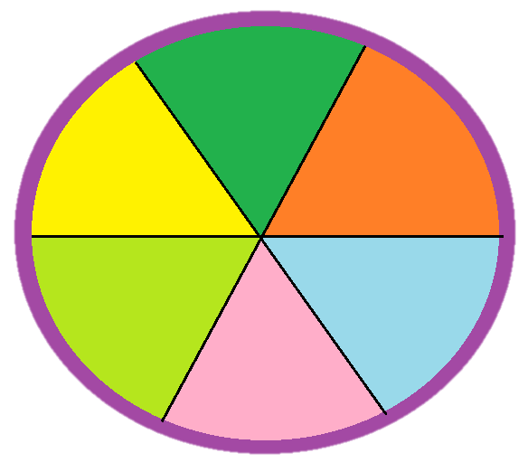







Game
THINGS WE MIGHT DO IN THE FUTURE
9
7
5
4
8
2
6
1
3
10
0
TIME’S UP

Slide 14






Go to school
go on holiday to the beach
Send postcards to friend
Take pictures with our cameras
Watch new films in the cinema
Have a telephone at home

Slide 15



Find the appropriate pharse on the circle. Make the sentences about the future using won’t & might
9
7
5
4
8
2
6
1
3
10
0
Take pictures with our watches
Go on holiday to the Moon
TIME’S UP
Go on holiday to the beach
Watch films on smart phones
Send video cards to friends
Study on computers at home
Call friends on our computers
check
In the future , we won’t go on holiday to the beach but we might go on holiday to the Moon

Slide 16
Go to school
go on holiday to the beach
Send postcards to friend
Take pictures with our cameras
Watch new films in the cinema
Have a telephone at home

Slide 17
Find the appropriate pharse on the circle. Make the sentences about the future using won’t & might
9
7
5
4
8
2
6
1
3
10
0
Take pictures with our watches
Go on holiday to the Moon
TIME’S UP
Go to school
Send video cards to friends
Watch films on smart phones
Study on computers at home
Call friends on our computers
check
In the future , we won’t go to school but we might study on computers at home

Slide 18
Go to school
go on holiday to the beach
Send postcards to friend
Take pictures with our cameras
Watch new films in the cinema
Have a telephone at home

Slide 19
Find the appropriate pharse on the circle. Make the sentences about the future using won’t & might
9
7
5
4
8
2
6
1
3
10
0
Take pictures with our watches
Go on holiday to the Moon
Take pictures with our cameras
TIME’S UP
Send video cards to friends
Watch films on smart phones
Study on computers at home
Call friends on our computers
check
In the future,we won’t take pictures with our cameras but we might take pictures with our watches

Slide 20
Go to school
go on holiday to the beach
Send postcards to friend
Take pictures with our cameras
Watch new films in the cinema
Have a telephone at home

Slide 21
Find the appropriate pharse on the circle. Make the sentences about the future using won’t & might
9
7
5
4
8
2
6
1
3
10
0
Take pictures with our watches
Go on holiday to the Moon
Have telephones
at home
TIME’S UP
Send video cards to friends
Watch films on smart phones
Study on computers at home
Call friends on our computers
check
In the future ,we won’t have telephones at home but we might call friends on our computer

Slide 22
Go to school
go on holiday to the beach
Send postcards to friend
Take pictures with our cameras
Watch new films in the cinema
Have a telephone at home

Slide 23
Find the appropriate pharse on the circle. Make the sentences about the future using won’t & might
9
7
5
4
8
2
6
1
3
10
0
Take pictures with our watches
Go on holiday to the Moon
TIME’S UP
Watch new films in the cinema
Send video cards to friends
Watch films on smart phones
Study on computers at home
Call friends on our computers
check
In the future ,we won’t watch new films in the cinema but we might watch film on smart phones

Slide 24
Activity 2 : Class survey
Home in the future
Read the question below. Tick (√ ) ‘Yes’ or ‘No’
Questions | YES | NO
Will you live in a hi-tech house?
2. Will your house be in space?
3. Will you have a lot of trees and flowers around your house?
4. Will you have a fridge that can cook your meal?
5. Will you have a robot that can look after your children
6. Will you have a car to fly into space?

Slide 25
Activity 2: Class survey
Home in the future
b, Find a partner to make a dialogue. Use the question in part a to interview your partner
e.g
You : Hi, Nam. Will you live in a hi-tech house in the furture
Nam: Yes, I will
You : Will your house be in a space ?
Nam: Oh ,no. It won’t
You : So where will it be ?
Nam : I’m not sure. It might be by the sea

Slide 26

Class survey
Home in the future
c, Tell the class about your interview

Slide 27

Let’s play
The hot bag

Slide 28
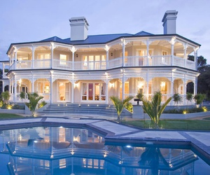
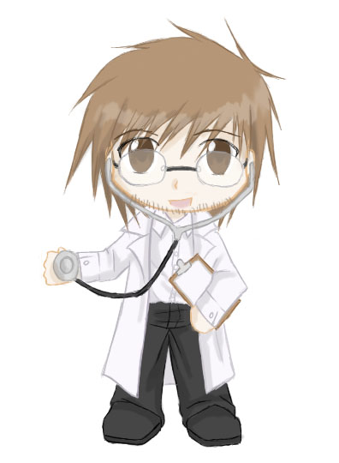
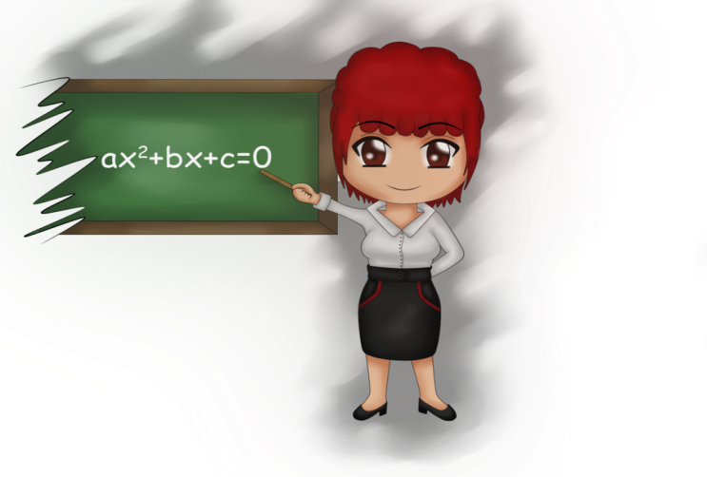
HOMEWORK!!!
WRITE A PARAGRAPH ABOUT YOUR DREAM JOB, DREAM HOUSE, DREAM CAR OR ANY THING YOU WANT TO HAVE IN THE FUTURE
(6-8 sentences)
SUBMIT IN THE NEXT LESSON

