Slide 1
Core Values
Wednesday, March 15, 2023

Slide 2
Definition
Personal ethics or ideals that guide you when making decisions, building relationships and solving problems.

Slide 3

Example - Microsoft
Citizenship
Trustworthy Computing
Innovation
Diversity and Inclusion
Environment
This Photo by Unknown Author is licensed under CC BY

Slide 4
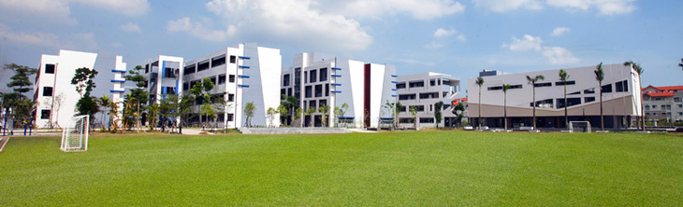
Example – St. Paul American School Hanoi
Respect
Integrity
Honesty
Responsibility
Creativity

Slide 5
Personal Core Values
Loyalty
Duty
Respect
Selfless Service
Honor
Integrity
Personal Courage

Slide 6
Why are core values important?
They show what is most important to an individual or organization.
They help guide actions.
They are necessary in the workplace and higher learning, but we are not teaching them to our students.
They establish common ground in a global environment.

Slide 7
Examples of Core Values
Integrity | Respect | Honor | Loyalty | Spirituality
Humility | Compassion | Kindness | Selflessness | Determination
Generosity | Courage | Tolerance | Appreciation | Empathy
Self-Reliance | Attentiveness | Balance | Citizenship | Competency
Wisdom | Poise | Love | Contribution | Transparency

Slide 8
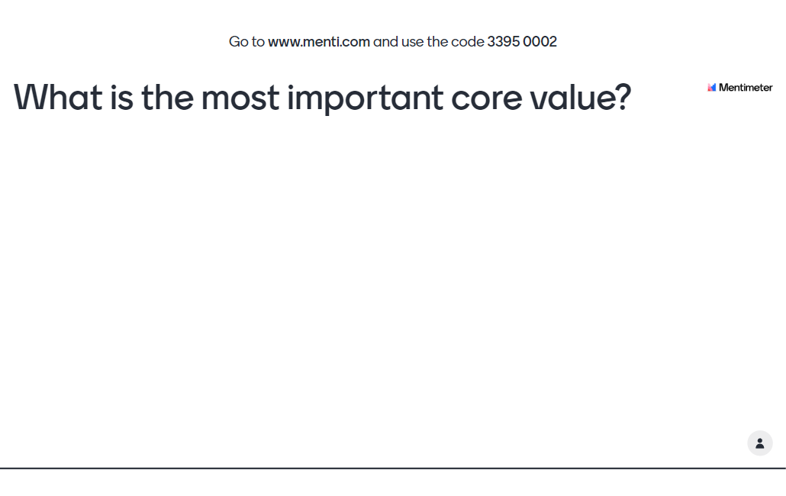
menti.com code = 3395 0002

Slide 9
Practical Applications - Individual
Create new list each year or revise current list
  Ideal is 3 – 5 core values
  One-word e.g. “Courage”
  Mantra “Progress, not perfection”
Keep a journal
  Did I live my core values today?
  Where did I fail to live up to my core values today?
  How can I improve?

Slide 10
Example of Individual Reflection - DEIJ
Loyalty – Yes: I got feedback from all stakeholders.
Duty – Yes: I am serving my school community and their interests.
Respect – Yes: I am honoring the beliefs of others despite my personal beliefs.
Selfless Service – Yes: I am not doing this for extra reward or recognition.
Honor – Yes: Staying true to my core values.
Integrity – Yes, even if it is difficult to leave the HAC, I will do what’s best for my community.
Personal Courage – Yes: Despite opposition from the other directors, I voiced my concerns without hesitation.

Slide 11
Practical Application - Students
Follow your school’s core values
If school does not have, work with your students to create:
  What are the core values most important to students?
  What core values are students good at? What core values are they lacking?
  What core values do teachers believe students need to be successful?
  Create a list of 3-5 core values
Focus on one core value per month e.g. January – Respect, February – Creativity
Include core value into every lesson

Slide 12
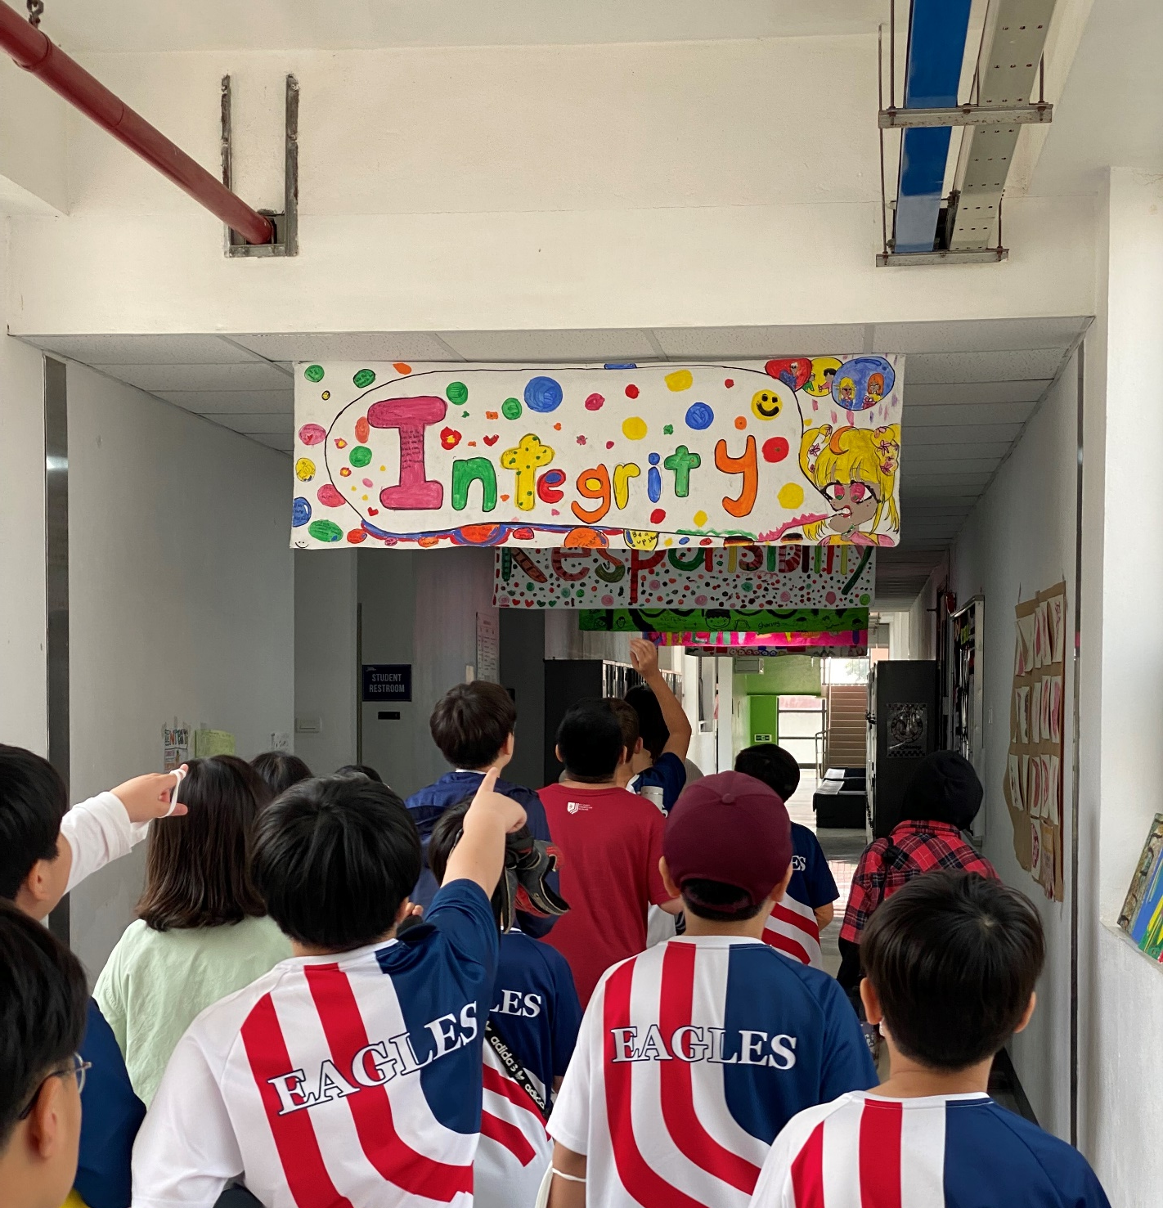
Practical Application – Students cont.
When a student does something well or not so well, refer to the core values
Display the core values
Share the core values with parents, administrators and other teachers
Model the core values for your students
Hold each other accountable

Slide 13
Exercise – Choose Core Values
Create a list of three core values
Share them with the person sitting next to you
Describe how you did or did not live up to them today

Slide 14

Share your core values…
#CoreValuesHanoi

Slide 15

Questions?

