Slide 1
REVIEW 3:
Unit 7 – 8 – 9
LESSON 1: LANGUAGE

Slide 2
Objective
By the end of the lesson, students will be able to:
- Review pronunciation, vocabulary and the grammar points they have learnt in unit 7, 8, 9.

Slide 3
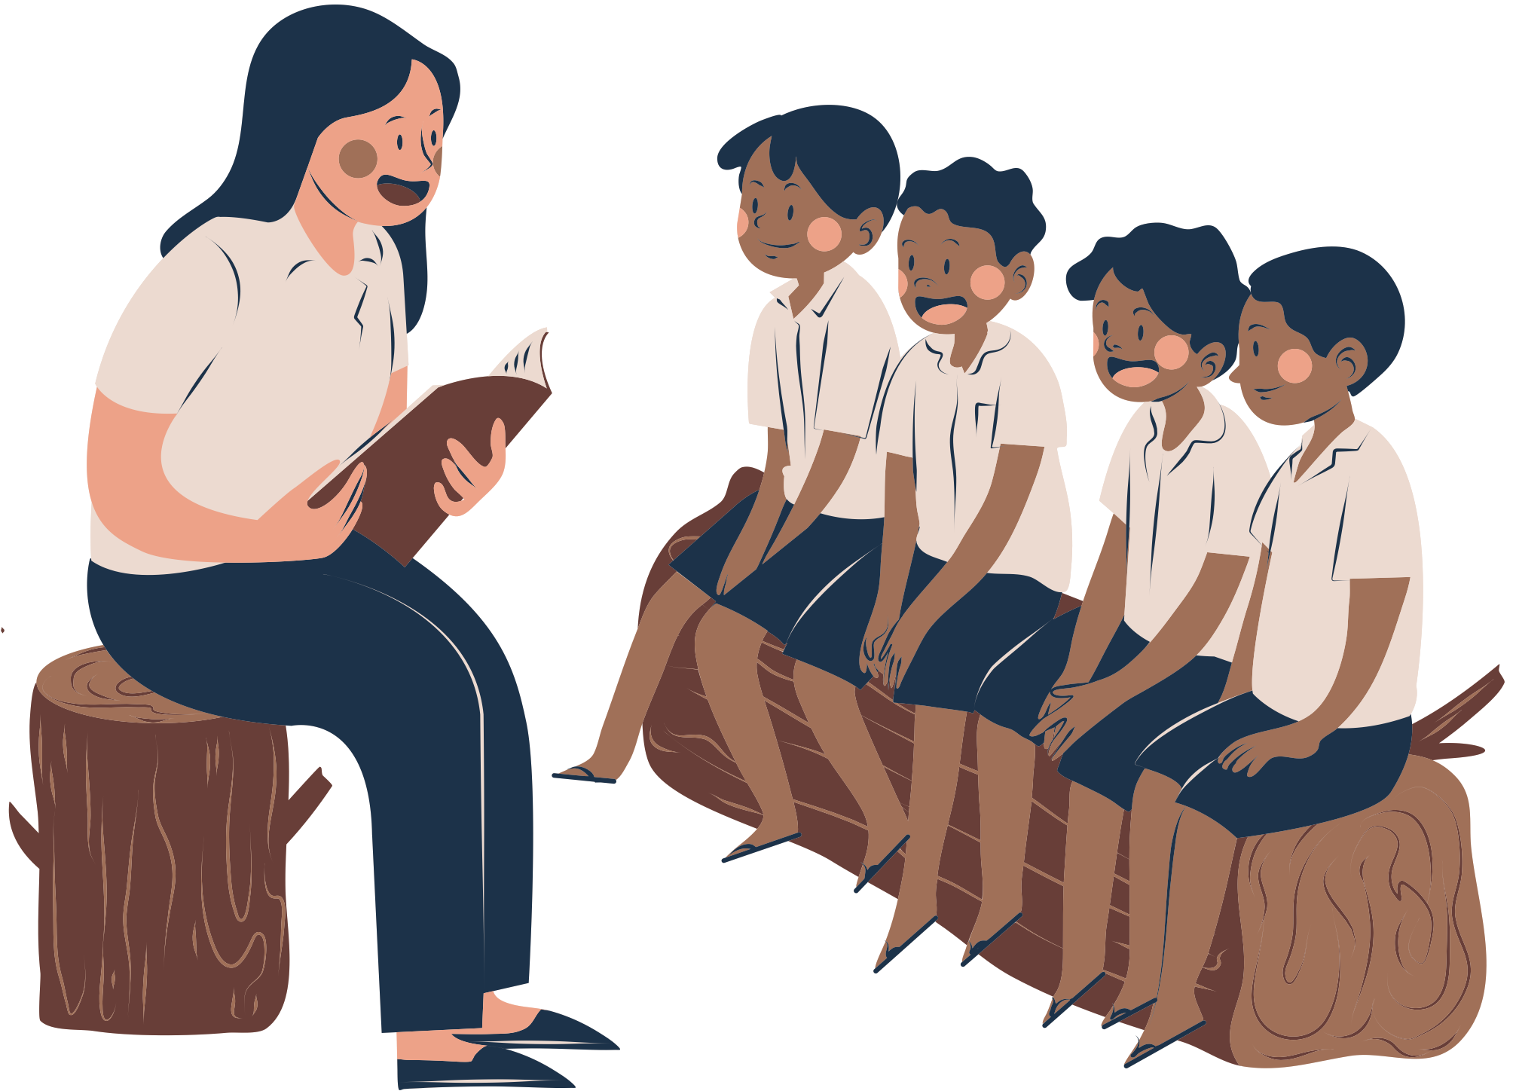
Pronunciation
/θ/ and /ð/
/e/ and /æ/
/əʊ/ and /aʊ/

Slide 4
Ex 1: Circle the word with the different underlined sound. Listen and check.
1. A. tower B. how C. snow
2. A. symbol B. opening C. postcard
3. A. farther B. earth C. both
4. A. Saturday B. racket C. game
5. A. tennis B. prepare C. chess
/ˈtaʊər/ /haʊ/ /snəʊ/
/ˈsɪmbəl/ /ˈəʊ.pən.ɪŋ/ /ˈpəʊstkɑːd/
/ˈfɑːðə/ /ɜːθ/ /bəʊθ/
/ˈsætədeɪ/ /ˈrækɪt/ /ɡeɪm/
/ˈtɛnɪs/ /prɪˈpeə/ /ʧɛs/

Slide 5

Vocabulary
Unit 7. Television
TV programmes
Unit 8. Sports and games
Unit 9: Cities around the world
Cities and landmarks

Slide 6
Ex 2: Choose A, B, or C to fill the gaps in the passage.
Most children love (1) ______ activities when the weather is good. They play football, go skateboarding or go (2) ______. In countries with a lot of snow like (3) ______, children go skiing with their parents to practise skiing. When they are not skiing, they can stay at home and watch interesting (4) ______ on TV or visit (5) ______ in the area.
1. A. outdoor B. indoor C. school
2. A. tennis B. karate C. swimming
3. A. Sweden B. India C. Brazil
4. A. characters B. viewers C. programmes
5. A. sports B. city C. landmarks
outdoor activities: hoạt động ngoài trời.
go swimming: đi bơi, play tennis: chơi quần vợt,
do karate: tập võ ka- ra- tê
programme (n): chương trình truyền hình,
character (n): nhân vật,
viewer (n): người xem
sport (n): thể thao, city (n): thành phố,
landmark (n): danh lam thắng cảnh

Slide 7
Ex 3: Complete the sentences with the words / phrase in the box.
football | city | landmark | television | summer sports
1. The Eiffel Tower is a famous ………………. in Paris.
2. Pelé is a great ……………. player from Brazil.
3. There are many educational programmes on …………….
4. I think no other ……… in the world is more interesting than Los Angeles.
5. …………….……….… are very popular in countries with a lot of sunshine like Australia.
famous landmark: danh lam thắng cảnh nổi tiếng
landmark
football
footbal player: cầu thủ bóng đá
television
education programmes: chương trình về giáo dục
city
television: vô tuyến truyền hình
Summer sports
more (adj) than: công thức so sánh hơn
summer sports: thể thao mùa hè

Slide 8

Grammar
- Wh- questions
- Conjunctions in compound sentences: and, but, so
- Past simple
- Imperatives
- Possessive adjectives
- Possessive nouns

Slide 9
Ex 4: Choose the correct answer A, B, or C.
1. John, you are late. The match ____________ ten minutes ago.
A. starts B. started C. is starting
2. Ben wrote his parents a postcard ____________ he was on holiday.
A. Because B. and C. while
3. Hong Kong is famous for ____________ double-decker buses.
A. its B. it C. it’s
4. Sports and games ____________ an important part in our lives.
A. play B. plays C. played
5. The USA first ____________ colour TV in 1953.
A. has B. have C. had
6. We are now in the city museum. ____________ any objects on display.
A. Not touch B. Don't touch C. Don't touching
Past simple: S + V-ed
because: bởi vì
and: và
while: trong khi
famous for: nổi tiếng vì
its (adj): của nó
it (n): nó
play an important part: đóng một vai trò quan trọng
Don’t touch: không được chạm vào
display: trưng bày

Slide 10
Ex 5: Correct the underlined question word(s) if needed.
1. Who sports do you like?
2. What time do you have English classes?
3. What do you like Hoi An?
4. What tall are the Twin Towers in Kuala Lumpur?
5. When is the Great Wall: in China or in Korea?
Đâu là môn thể thao bạn thích?
Bạn có các lớp Tiếng Anh chứ?
Bạn thích Hội An ở điểm gì?
Toà tháp đôi ở Kuala Lumpur cao bao nhiêu?
Vạn Lý Trường Thành ở Trung Quốc hay Hàn Quốc
What
Do
Why
How
Where

Slide 11
Thanks!
Do you have any questions?

