Slide 1
Review 3
Unit 7 – 8 – 9
LESSION 2: SKILLS

Slide 2
Objective
01
03
02
04
Reading
Listening
- about a TV guide
- about favourite sports stars
- about a holiday postcard
- about different TV programmes
- about sport(s) / game(s)
- about a description of a city
Speaking
Writing
- about a favourite TV programme
- about famous sportspeople
- about a city
- a paragraph about TV-viewing habits
- a paragraph about a sport / game
- a holiday postcard

Slide 3

01
Reading

Slide 4
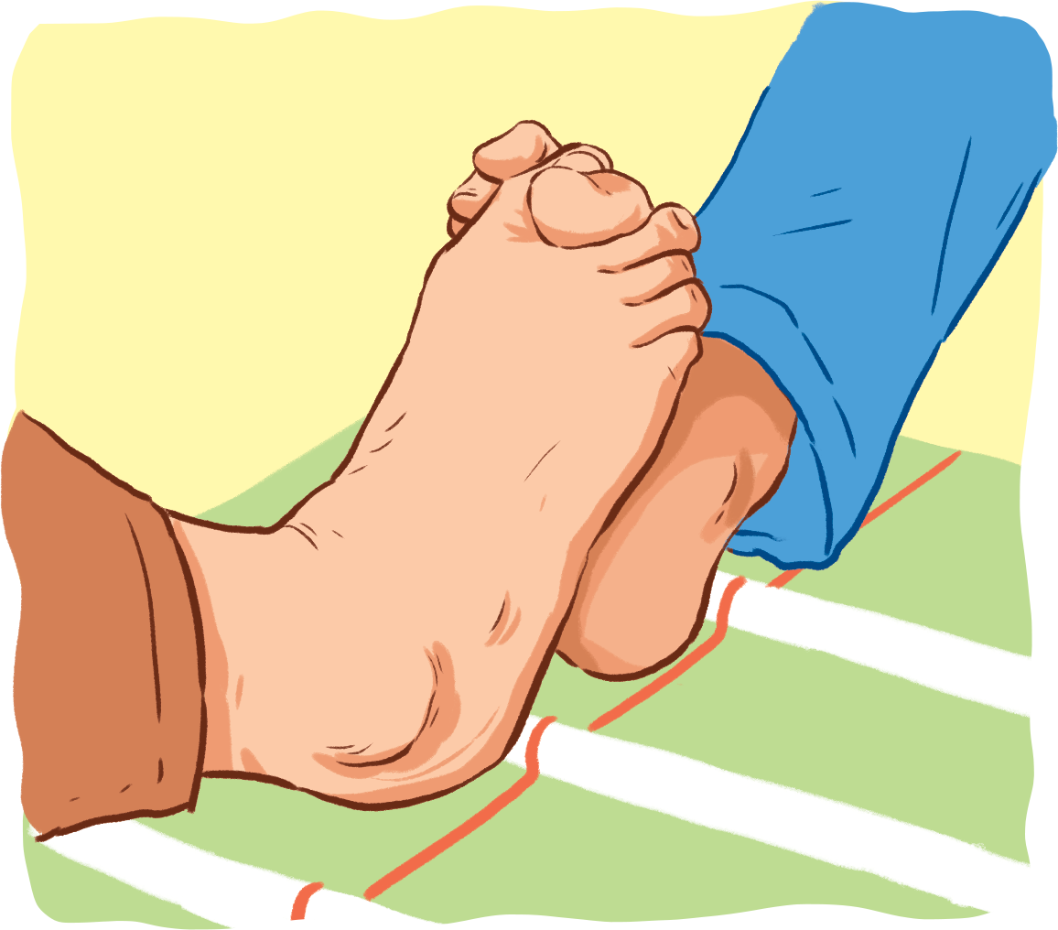
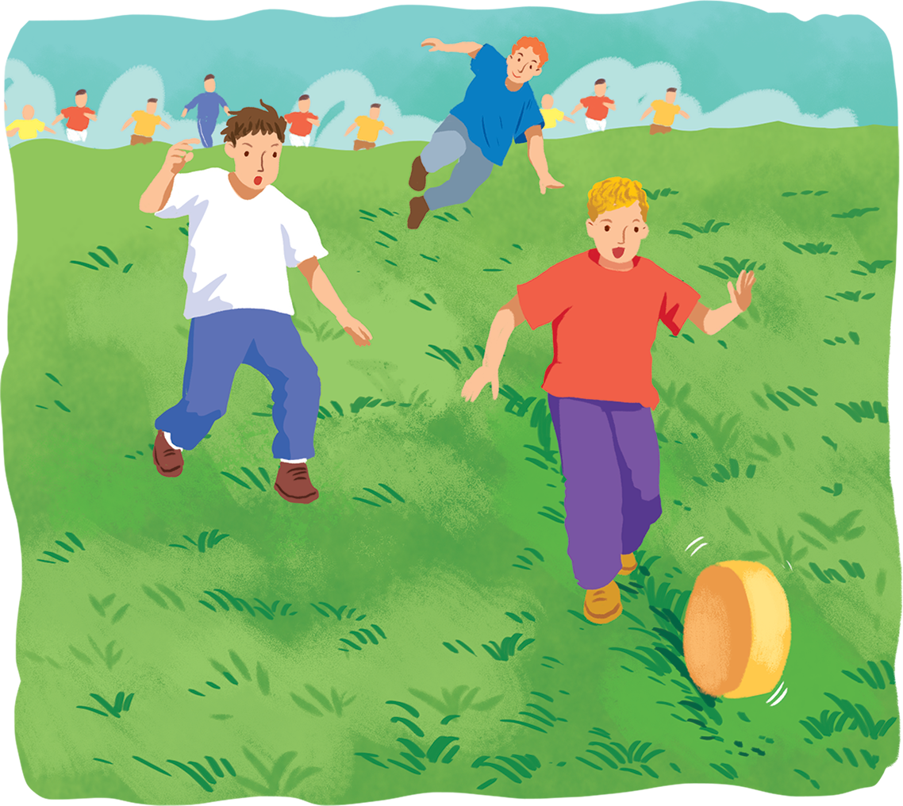
Ex 1: Read the two descriptions of strange sports and choose titles for them.
A. Toe Wrestling
B. Cheese Rolling
1.
2.
It's a simple sport. Competitors roll a big round piece of cheese from the top of a hill. Competitors run after it and try to catch it. Very few people can catch it because it goes very fast, about 112 km an hour.
It's a popular sport for children. This game started in Derbyshire in the North of England. Two children lock their toes together and try to push the other's foot to the ground. It's similar to arm wrestling.
a big round piece of cheese
run after it and try
to catch it.

Slide 5
Ex 1: Read the two descriptions of strange sports and choose titles for them.
A. Toe Wrestling
1.
2.
B. Cheese Rolling
It's a simple sport. Competitors roll a big round piece of cheese from the top of a hill. Competitors run after it and try to catch it. Very few people can catch it because it goes very fast, about 112 km an hour.
It's a popular sport for children. This game started in Derbyshire in the North of England. Two children lock their toes together and try to push the other's foot to the ground. It's similar to arm wrestling.
a big round piece of cheese
run after it and try
lock their toes together
to catch it.
and try to push the other’s foot
to the ground
similar
wrestling

Slide 6
Ex 1: Read the two descriptions of strange sports and choose titles for them.
1.
2.
B. Cheese Rolling
A. Toe Wrestling
It's a simple sport. Competitors roll a big round piece of cheese from the top of a hill. Competitors run after it and try to catch it. Very few people can catch it because it goes very fast, about 112 km an hour.
It's a popular sport for children. This game started in Derbyshire in the North of England. Two children lock their toes together and try to push the other's foot to the ground. It's similar to arm wrestling.
a big round piece of cheese
run after it and try
lock their toes together
to catch it.
and try to push the other’s foot
to the ground
similar
wrestling

Slide 7
Ex 2: Use the information from the passages above to tick (✔) the correct box.
It's a simple sport. Competitors roll a big round piece of cheese from the top of a hill. Competitors run after it and try to catch it. Very few people can catch it because it goes very fast, about 112 km an hour.
Cheese Rolling
It's a popular sport for children. This game started in Derbyshire in the North of England. Two children lock their toes together and try to push the other's foot to the ground. It's similar to arm wrestling.
top of a hill
North of England
Very few people
their toes
can catch it
about 112 km an hour
Toe Wrestling
 | Toe Wrestling | Cheese Rolling
1. You need a hill to play this sport.
2. You use the lower part of the body for this sport.
3. It travels at about 112km/h.
4. Not many people can catch it.
5. It first started in England.
✔
✔
✔
✔
✔

Slide 8

Speaking
02
Ex 3: Work in groups. Interview your classmates about their likes. Take notes of their answers and report to the class.
Questions | Person 1 | Person 2
1. What city would you like to visit?
2. What sports do you like playing?
3. What TV programme do you like watching?

Slide 9
03
Listening

Slide 10

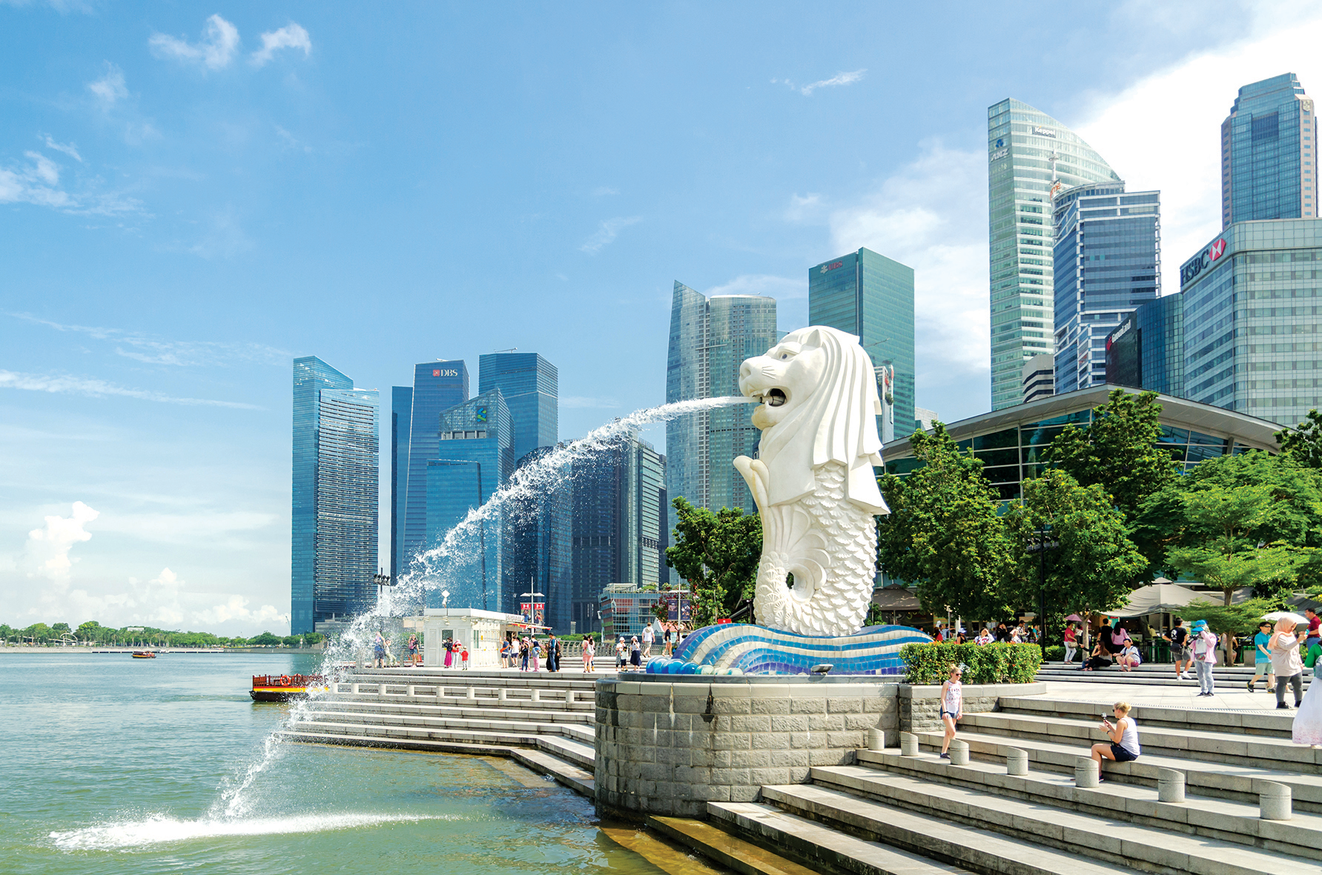
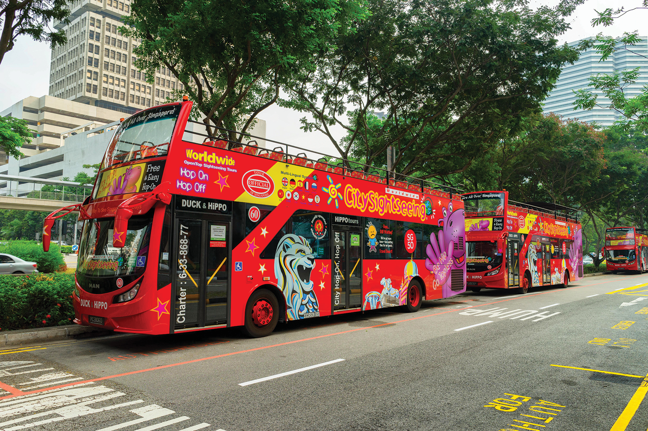
Ex 4: Listen to a talk about Singapore and fill the missing information.
Singapore attracts millions of (1) every year.
A hop-on hop-off bus goes (2) around the city.
The cost of the tour is (3) dollars.
The bus comes every (4) minutes.
This tour is good for people with (5) time.
visitors
slowly
35
30
Merlion Park
little
This kind of sightseeing is good for people with little time in the city
There is a bus every 30 minutes.
It attracts millions of visitors every year.
The tour costs 35 dollars
The bus goes slowly around the city.
Hop-on hop-off bus

Slide 11
Audio script
Singapore is a small island city-state. It attracts millions of visitors every year. A good way to see the city is by taking a hop-on hop-off bus. The bus goes slowly around the city. It stops at different attractions like Chinatown and Merlion Park. You can get off the bus at any place, and then get on the next bus. The tour costs 35 dollars, and there is a bus every 30 minutes. This kind of sightseeing is good for people with little time in the city.

Slide 12
04
Writing

Slide 13
Ex 5: Look at the information on Mark’s visit to India last summer. Write a paragraph of about 50 words about his visit.
You can start with:
Last summer, Mark visited Delhi in India.
He
Country | India
Time | 7 days
City | Delhi
Activities | – watch a snake performance – visit temples – eat street food
People | friendly
Weather | hot
spent seven days there. During his holiday, he went sightseeing around the city. He watched a snake performance, visited some temples, and ate street food. The people he met were friendly and helpful. The only thing he didn't like was the weather. It was very hot.

Slide 14
THANKS!
Do you have any questions?

