Slide 1


Slide 2
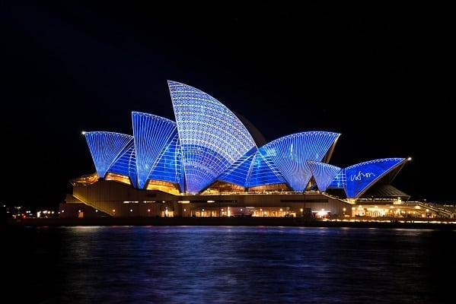
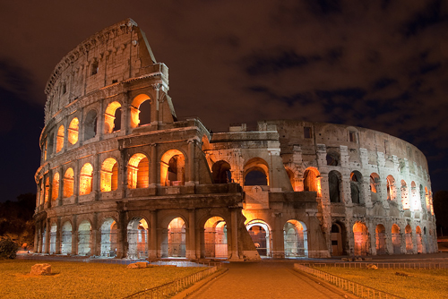
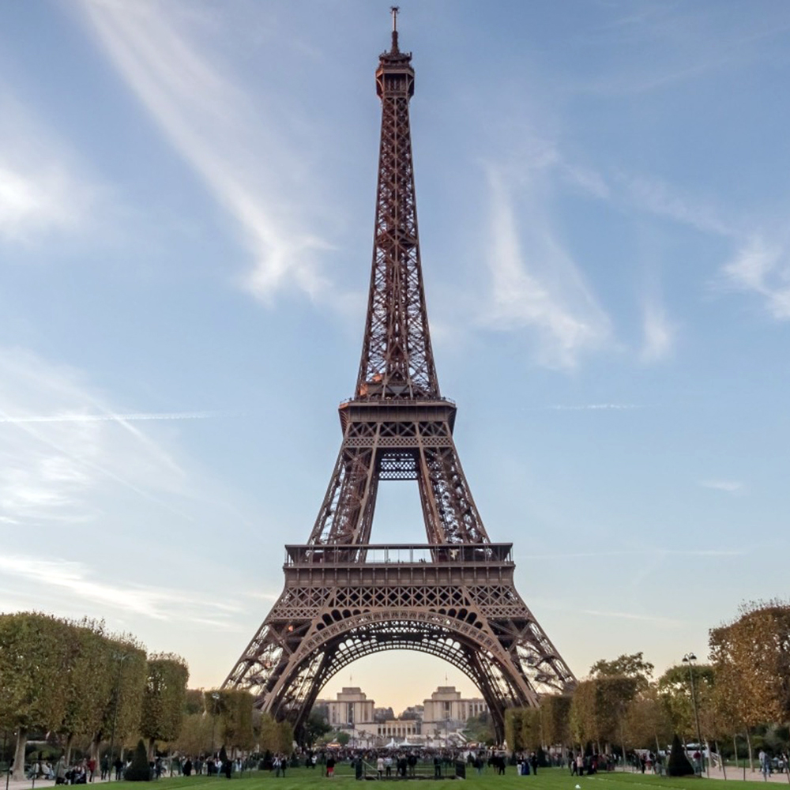
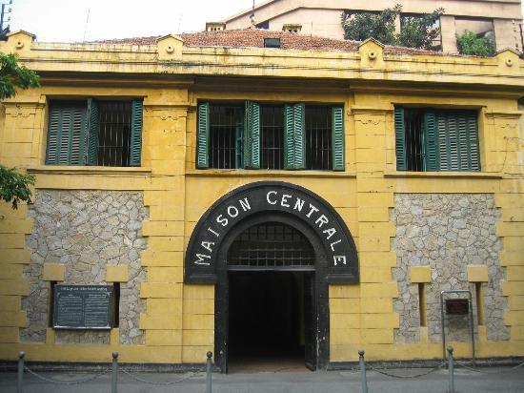
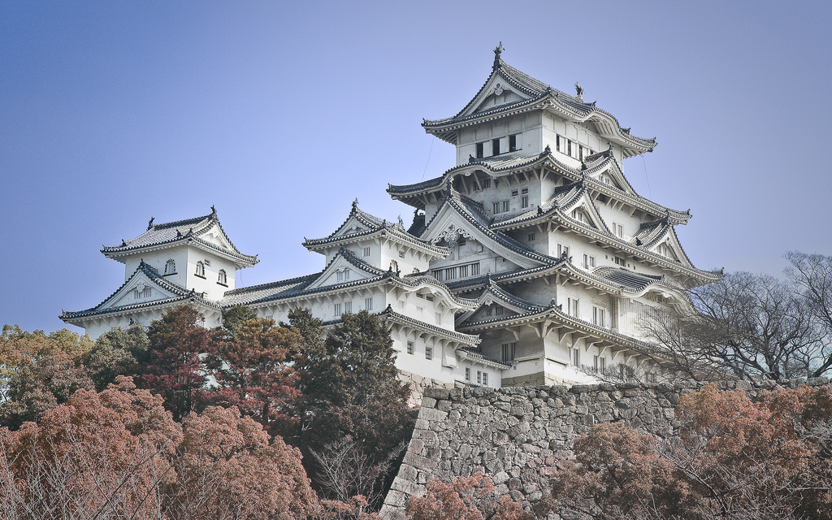
Roma Arena – Rome – Italy
Eiffel tower – Paris - France
Opera house – Sydney- Australia
Himeji Castle – Osaka – Japan
Hoa Lo Prison – Hanoi - Vietnam

Slide 3
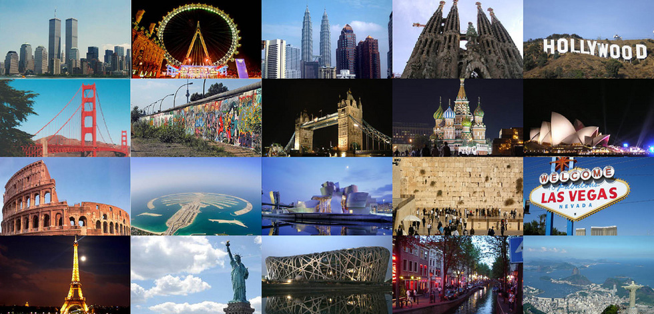
CITIES OF THE WOLRD
Unit 9
Lesson 1 – Getting started – What nice photos!

Slide 4
Activity 1:
Listen And Read
Vocabulary
- exciting (a) /ik'saitiη/: lý thú
- clean (a) /kli:n/: sạch
- bad (a) /bæd/ : xấu
- beautiful (a) /'bju:tiful/: đẹp
- modern (a) /'mɔdən/: hiện đại
- eggs-shaped (a) /eg-∫eipt/: hình bầu dục

Slide 5
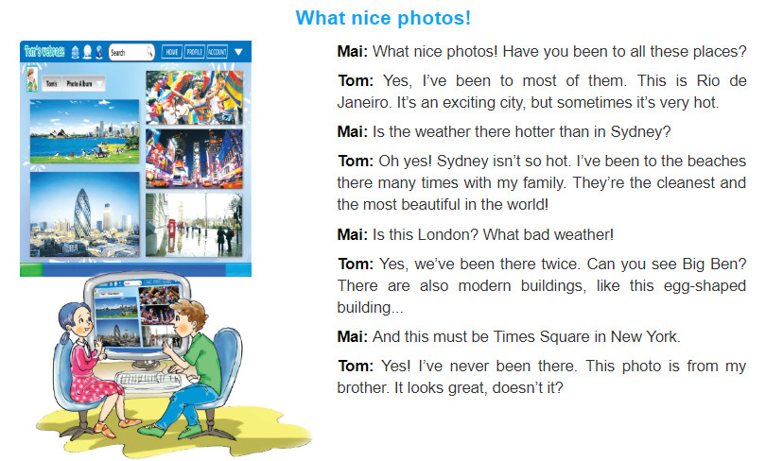
Activity 1:
Listen And Read
Here you have a list of items
And some text
But remember not to overload your slides with content
Your audience will listen to you or read the content, but won’t do both.

Slide 6
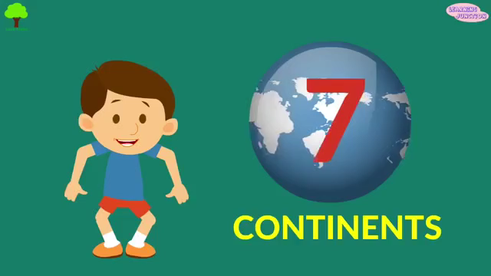
Let’s start with the first set of slides

Slide 7
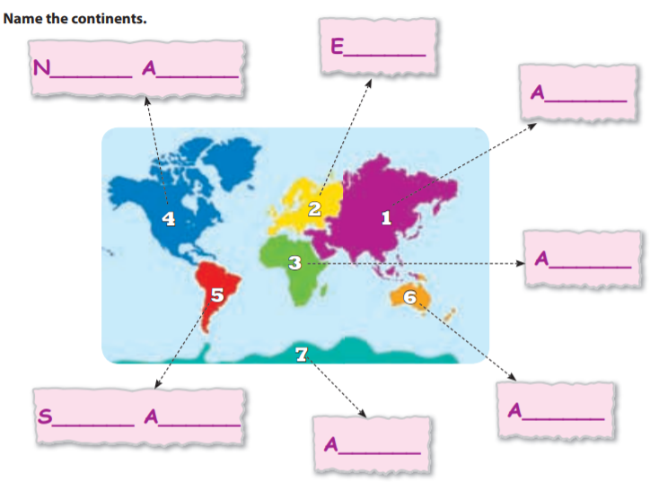
Activity 3:
EUROPE
/ˈjʊərəp/
NORTH AMERICA
/ˌnɔːθ əˈmerɪkə/
ASIA
/ˈeɪʒə/
Blue
Is the colour of the clear sky and the deep sea. It is located between violet and green on the optical spectrum.
AFRICA
/ˈæfrɪkə/
SOUTH AMERICA
/ˌsaʊθ əˈmerɪkə/
AUSTRALIA
/ɒsˈtreɪ.li.ə/
ANTARCTICA
/ænˈtɑːrktɪkə/

Slide 8


Slide 9


