Slide 1
Unite 9: CITIES OF THE WORLD
LESSON 1: GETTING STARTED

Slide 2
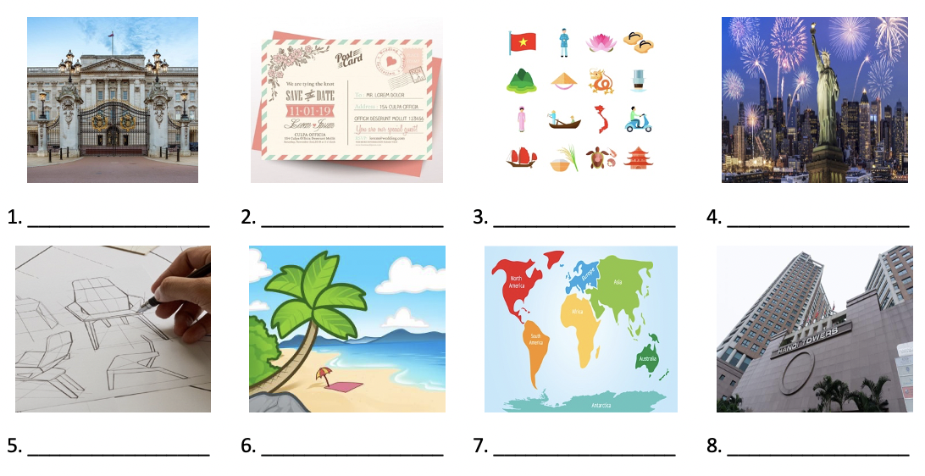
Look at the pictures and complete the blanks with the words given
continent | design | landmark | tower
beach | symbol | palace | postcard
palace
postcard
symbol
landmark
design
beach
continent
tower

Slide 3
Reorder the words and phrases to make complete sentences.
→ Are these photos from your holidays?
1. photos / your / from / Are / these / holidays / ? /
2. a lot / exciting / beaches / Sydney’s / with / of / . /
→ Sydney’s exciting with a lot of beaches.
3. London / Big Ben / is / of / landmark / a / . /
→ Big Ben is a landmark of London.
4. places / to / lucky / You’re / many / visit / . /
→ You’re lucky to visit many places.

Slide 4
Choose the best option to fill in the blank.
1. The Golden Gate Bridge is San Francisco’s most famous _________.
A. building B. monument C. palace D. landmark
2. _________ do you live in? - Asia.
A. Where B. What country C. What continent D. What city
3. "I have been to Nha Trang_____. How about you?"
A. one B. two C. two time D. twice
4. The package includes a tour of Sydney’s famous _________.
A. Opera House B. Eiffel Tower C. Big Ben D. White House
5. I really love living in Montreal _________ there are so many places to visit that are nearby.
A. but B. so C. because D. although
toà nhà vật kỉ niệm cung điện danh thắng
Where + do/does sb live in?
số một số hai hai lần (thiếu s) hai lần
Sydney’s famous
nhưng như thế bởi vì mặc dù

Slide 5
Complete the sentences with the suitable words given
well-known | symbols | designer | flights
interesting | been | exciting | buildings
1. New York is an ________ city with many skyscrapers.
2. Ben Thanh Market is one of the most famous_________of Ho Chi Minh City.
3. Every week, there are two ________ from Ha Noi to HCM city.
4. Time Square in New York is crowded but _______.
5. Have you ever ________ to London?
6. Hoan Kiem Place is regarded as one of the ____ landmarks in Ha Noi.
7. There are many modern ________ in Ho Chi Minh City.
8. He was a talented_______. He created many great buildings in big cities.

Slide 6
Complete the sentences with the suitable words given
well-known | symbols | designer | flights
interesting | been | exciting | buildings
1. New York is an ________ city with many skyscrapers.
2. Ben Thanh Market is one of the most famous_________of Ho Chi Minh City.
3. Every week, there are two ________ from Ha Noi to HCM city.
4. Time Square in New York is crowded but __________.
exciting
Ben Thanh Market
symbols
flights
from Ha Noi to HCM city
interesting

Slide 7
Complete the sentences with the suitable words given
well-known | symbols | designer | flights
interesting | been | exciting | buildings
5. Have you ever ______ to London?
6. Hoan Kiem Place is regarded as one of the __________ landmarks in Ha Noi.
7. There are many modern ________ in Ho Chi Minh City.
8. He was a talented_______. He created many great buildings in big cities.
ever
been
Hoan Kiem Place
well-known
buildings
designer
created many great buildings in big cities

Slide 8
Thanks!
SEE YOU AGIAN

