Slide 1
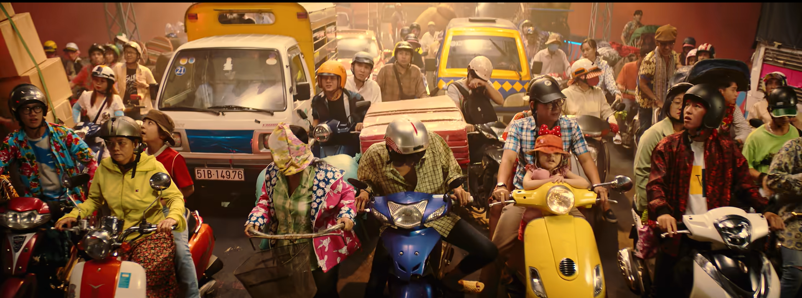
1. What do you think about the traffic in the picture?
2. How do people travel every day?
3. How about traffic in the future?
Notes:
Have students discuss in pairs in 2 minutes then lead intro the new unit “Travelling in the future”.

Slide 2
UNIT 11:
Travelling in the future
Lesson 1: Getting started

Slide 3
Objectives
1. Gain an overview and some vocabulary to talk about the topic TRAVELLING IN THE FUTURE.
2. Develop communication and team-work skills.

Slide 4

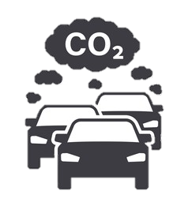


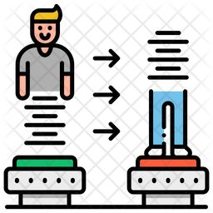
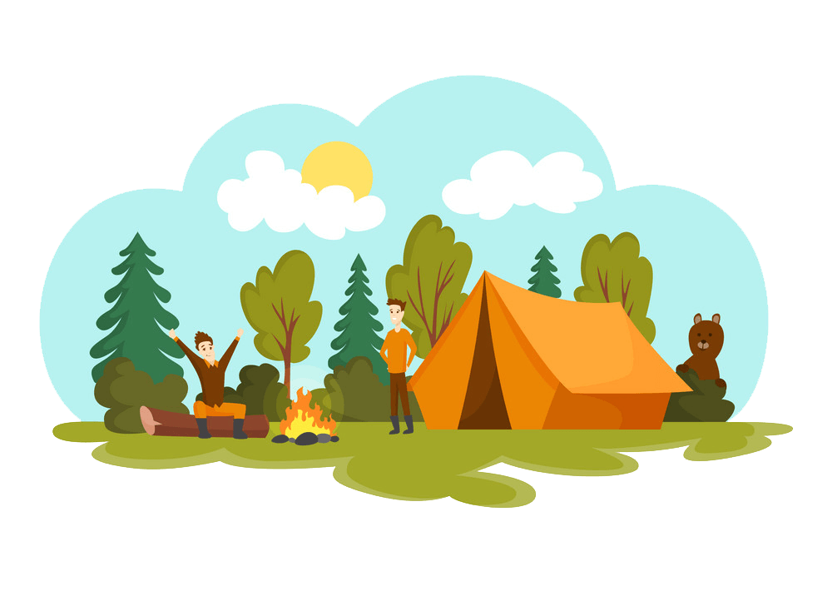
VOCABULARY
1 | Eco – friendly (a) /ˈiː.kəʊˌfrend.li/ | Thân thiện với môi trường
2 | Fume (n) /fjuːm/ | Khói, khí thải
3 | Hyperloop (n) /ˈhaɪ.pərluːp/ | Hệ thống giao thông tốc độ cao
4 | Teleporter (n) /ˈtel.ɪ.pɔː.tər/ | Phương tiện di chuyển tức thời
5 | Campsite (n) /ˈkæmp.saɪt/ | Địa điểm cắm trại

Slide 5
Ex 1. Listen and read. What are Ann and Minh talking about? (P.114)
Minh: Oh, another traffic jam.
Ann: How will we get to the campsite on time now?
Minh: I don’t know. It’s a pity that we don’t have a hyperloop now!
Ann: What’s a hyperloop?
Minh: It’s a system of tubes. You can go from one place to another in just minutes.
Ann: Amazing! Even faster than a flying car!
Minh: Yes, and there are no traffic jams.
Ann: Will it pollute the environment?
Minh: No. There will be no fumes, and it’s totally safe.
Ann: Like a teleporter?
Minh: A teleporter is also fast, safe and eco-friendly. But it’s a different mode of travel.

Slide 6

Ex 2. What are Ann and Minh talking about? (P.115)
Traveling by teleporter
Future modes of travel
Being in traffic jam

Slide 7
Ex 3. Work in pairs and tick T (True) or F (False)
 | T | F
1. Ann and Minh are in a traffic jam now.
2. Ann and Minh are going to school.
3. Ann knows a lot about hyperloops.
4. Minh seems to know about different modes of travel.
5.They hope there will be hyperloops soon.

Slide 8

Ex 4. Work in pairs to pick out words / phrases describe these means of transport: Hyperloop and teleporter (P.115)
Minh: Oh, another traffic jam.
Ann: How will we get to the campsite on time now?
Minh: I don’t know. It’s a pity that we don’t have a hyperloop now!
Ann: What’s a hyperloop?
Minh: It’s a system of tubes. You can go from one place to another in just minutes.
Ann: Amazing! Even faster than a flying car!
Minh: Yes, and there are no traffic jams.
Ann: Will it pollute the environment?
Minh: No. There will be no fumes, and it’s totally safe.
Ann: Like a teleporter?
Minh: A teleporter is also fast, safe and eco-friendly. But it’s a different mode of travel.
Notes:
WORK IN PAIRS in 1 minute then say bingo if your pair have finished

Slide 9
Hyperloop | Teleporter
Ex 4. Work in pairs to pick out words / phrases describe these means of transport (P.115)
a system of tubes
fast
faster than a flying car
safe
no traffic jams
eco-friendly
no fumes
safe

Slide 10
1. It has two wheels and you pedal it.
2. It has four wheels. It runs on petrol or electricity, and can carry up to eight passengers.
3. It carries many passengers and runs on tracks.
4. It sails on the sea. It needs wind to sail.
5. It travels in space. It can even carry people to the moon.
Bicycle / bike
WHAT IS
THAT
VEHICLE ?
Car
Train
Sail boat
Rocket / Spaceship

Slide 11
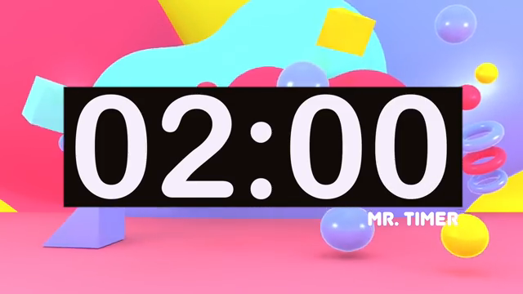
Future traveling
1. Work in pair in 2 minutes to choose your favourite traveling mode in the next 50 years.
2. Describe the vehicle with 3 sentences
3. Come to the board to say the sentences in turns and have the class guess the name of your vehicle
Notes:
Call up to 3-4 pairs

Slide 12
Mode of travel
that will be popular in the next 50 years?
Drone
Spaceship?
Flying car?
Rocket?
Sky train?
boat
Notes:
Pair discussion

Slide 13
Let’s wrap up
1. Name 2 modes of transport that might appear in the future.
2. Will there be traffic jams when using them.
3. Are they eco-friendly.
Hyperloop and Teleporter
No
Thanks for listening!
Yes

