Slide 1
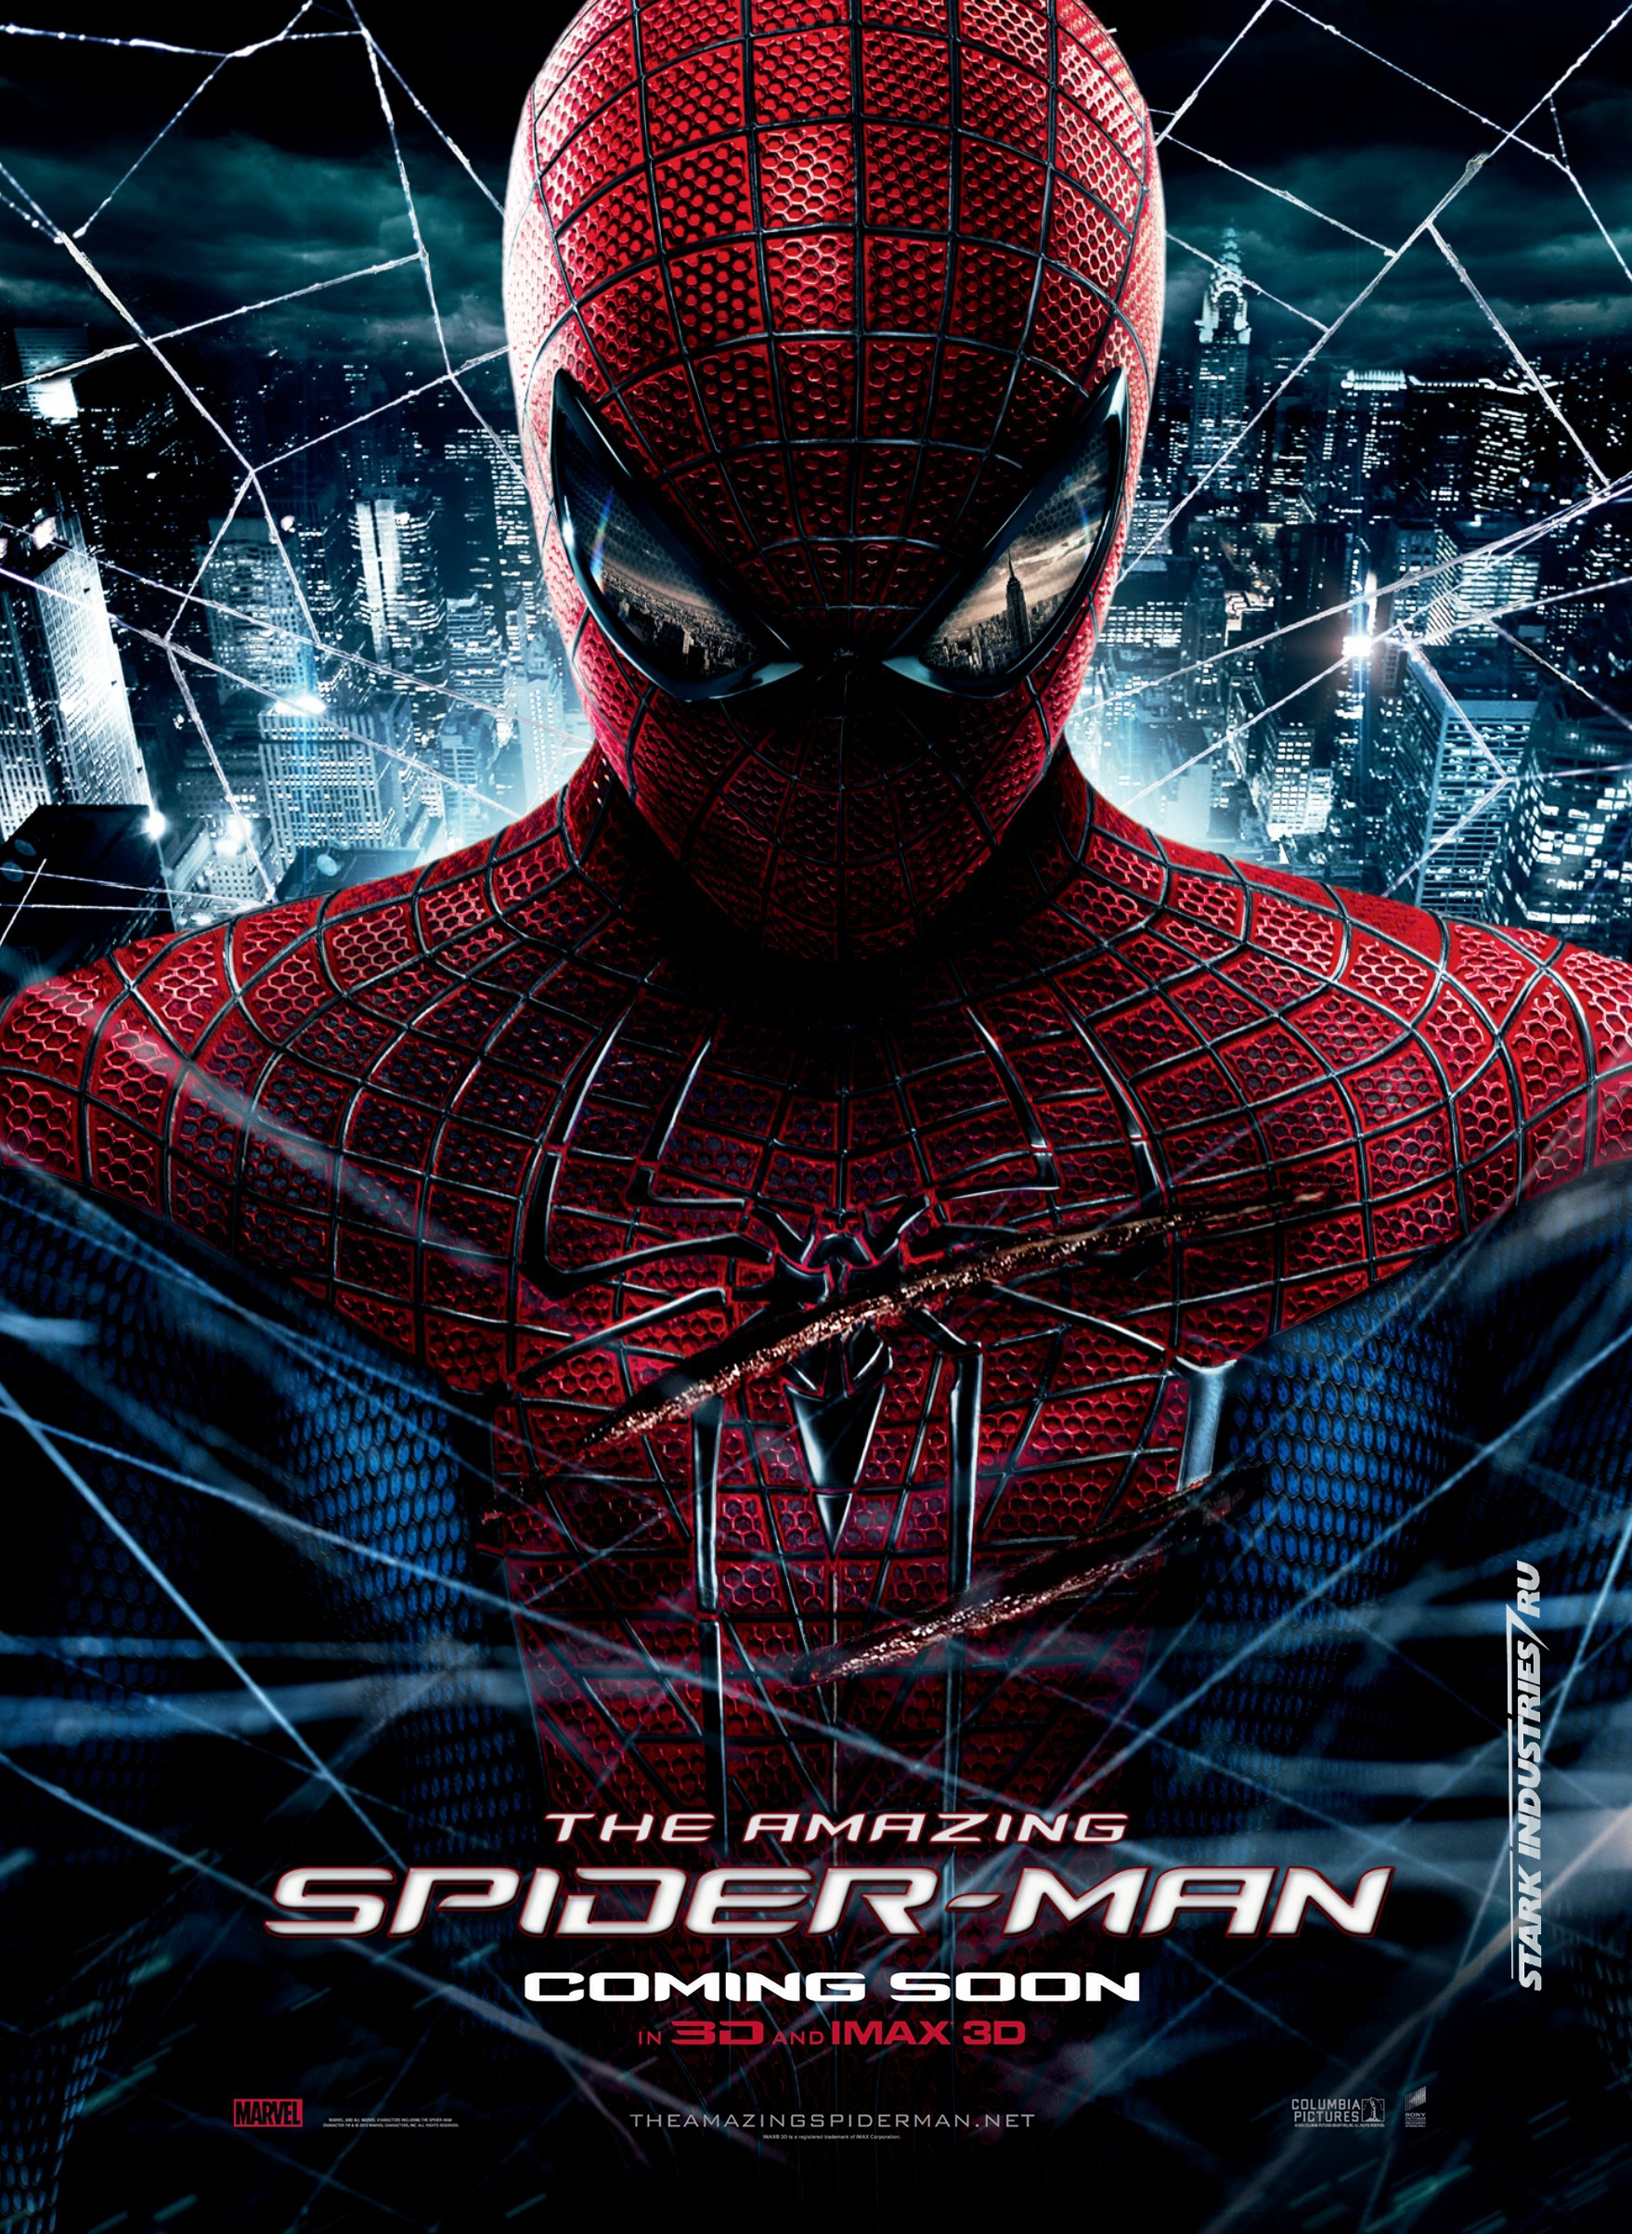

Slide 2


Slide 3
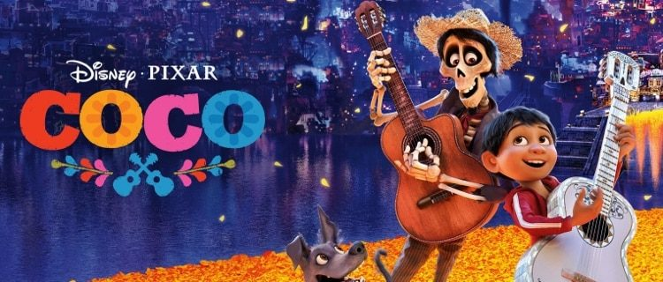
Add Your Title

Slide 4
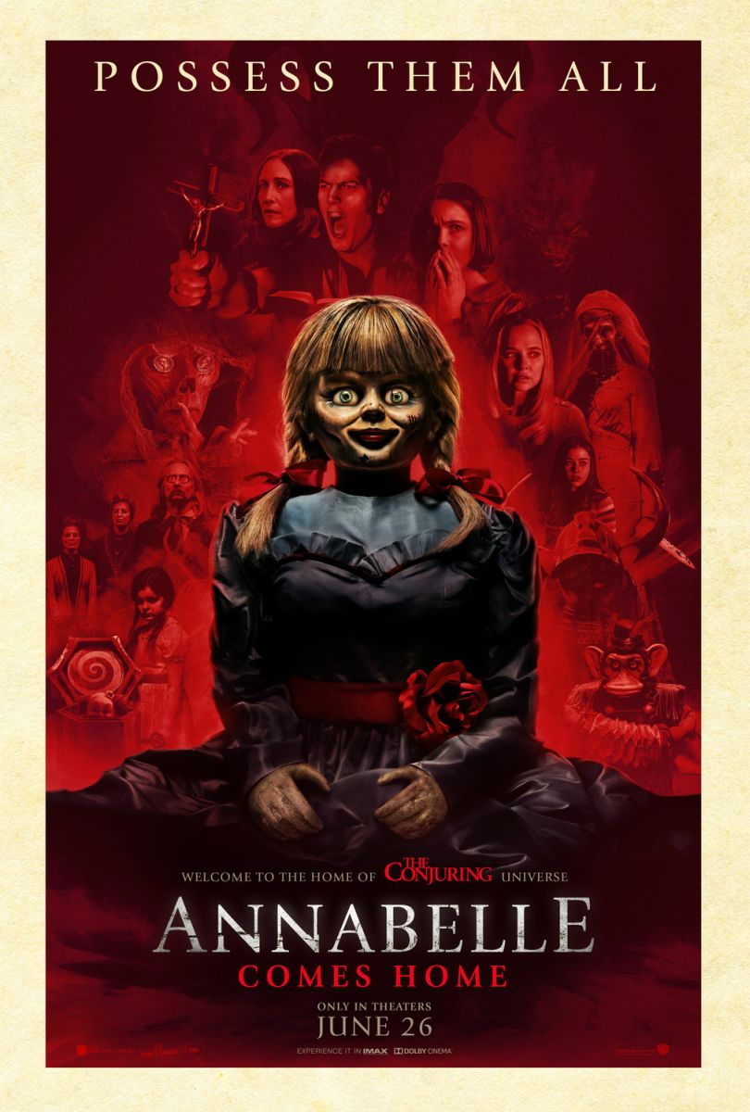

Slide 5


Slide 6

Unit 8
FILMS
Lesson 1: Getting Started – What film shall we see?

Slide 7
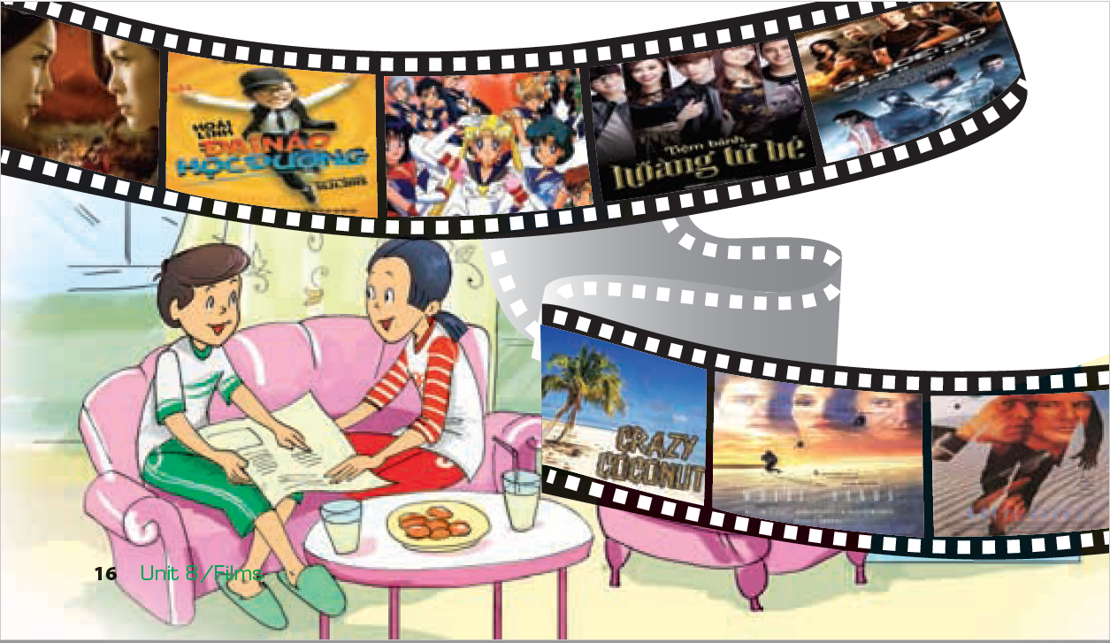
What are they talking about?

Slide 8
Listen and answer questions
1. What does Duong suggest doing tonight?
a. Watching a TV show. b. Watching a film. c. Staying at home.
2. Where does Duong find cinema information?
a. In a newspaper. b. By asking Mai. c. On the Internet.
3. What is the type of White Sands? – It’s ……………. film.
4. Why doesn’t Mai want to see White Sands?
a. She doesn’t like that type of film.
b. It’s not on at the right time.
c. She has seen the fi lm before.
5. What is the type of the film Crazy Coconut? – It’s ……………………..film.
6. Who does Crazy Coconut stars?
7. How do critics feel about Crazy Coconut?
a. They all like it. b. They don’t like it. c. Many of them like it.
8. Which film do Mai and Duong decide to watch?
a. White Sands. b. Crazy Coconut. c. They haven’t decided yet.
horror
romantic comedy
- Julia Roberts and Brad Pitt.

Slide 9

Let’s Stick
Stick the pictures and definitions on A1 papers.

Slide 10

a. science fiction (sci-fi)
3. A film that is set in the future, often featuring science.

Slide 11

b. romantic comedy
5. A film which combines comedy with a love story.

Slide 12
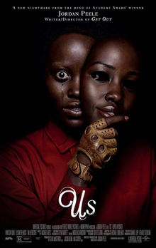
c. thriller
4. A film that tells an exciting story about murder or crime.

Slide 13

e. documentary
6. A film that shows real life events or stories.

Slide 14
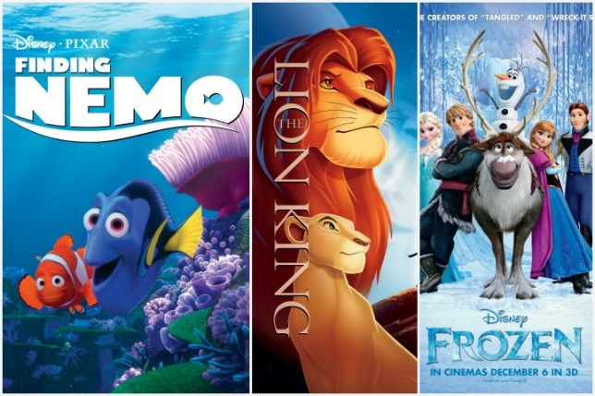
f. animation
2. A film that features cartoon characters.

Slide 15

g. action
8. A film that usually features lots of stunts and fighting.

Slide 16
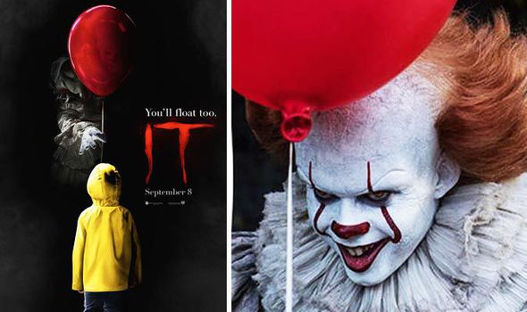
h. horror
7. A film in which strange and frightening things happen.

Slide 17
Types of films
- science fiction (sci-fi ) /ˈsaɪəns ˈfɪkʃn/
- romantic comedy /roʊˈmæntɪk ˈkɒmədi/
- thriller /ˈθrɪlə(r)/
- comedy /ˈkɒmədi/
- documentary / dɒkjuˈmentri/
- animation /ænɪˈmeɪʃn/
- action /ˈækʃn/
- horror /ˈhɔːrər/

Slide 18


Slide 19


