Slide 1
Unit 7:
Traffic
Lesson 1: Getting started

Slide 2
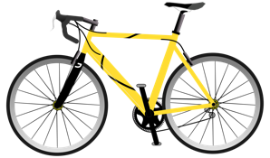
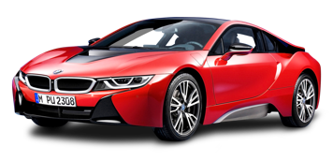
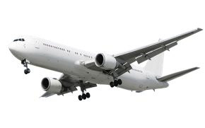
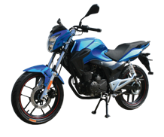
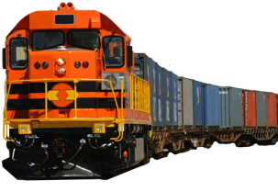
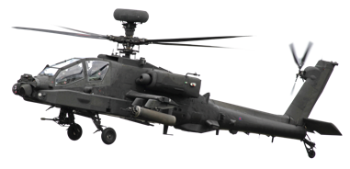

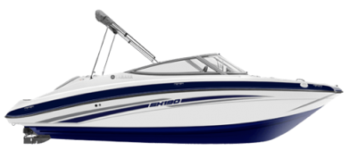
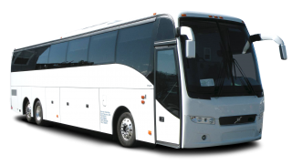
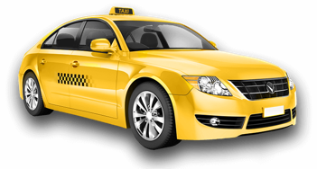
Look at the pictures and write a word under each.
1. ______________ | 2. ______________ | 3. ______________ | 4. ______________
5. ______________ | 6. ______________ | 7. ______________ | 8. ______________
9. ______________ | 10. ______________
bicycle
car
plane
motor bicycle
train
helicopter
ship
canoe
bus
taxi

Slide 3
Choose the word or phrase that best completes each sentence below.
1. All of us have to obey _____ strictly.
A. traffic B. traffic rules C. traffic jam D. regular
2. It is _____ for teenage under 18 to ride a motorbike in Vietnam.
A. legal B. legally C. illegally D. illegal
3. Yesterday Ba and Nga _____ round West Lake. It took them an hour.
A. cycled B. cycle C. cycling D. cycles
4. Hurry up or we can’t _____ the last bus home.
A. keep B. follow C. go D. catch
5. Pete and Liz used to go to school _____.
A. by foot B. on foot C. by feet D. on feet
Traffic rules: luật lệ Giao thông
Illegal: bất hợp pháp
Catch: bắt
On foot: đi bộ

Slide 4
Choose the word or phrase that best completes each sentence below.
6. They really enjoy _____ the boat.
A. driving B. catching C. sailing D. riding
7. When the bus stop, the students say goodbye to the driver and _____.
A. walk on B. walk of C. get on D. get off
8. His father is a pilot, and he has been _____ planes for 10 years.
A. flying B. fly C. flew D. flown
9. You are not _____ to drive to drive without buckling up.
A. allowed B. allowing C. allow D. allowance
10. We should _____ the street at the zebra crossing.
A. walk B. walk through C. walk on D. walk across
Sail the boat: chèo thuyền
Get off: xuống xe
Walk across the street: đi qua đường

Slide 5
Choose the underlined part that needs correcting in each sentence below.
1. There used to was much traffic in this area.
A. used B. was C. much D. in
2. How does our English teacher goes to work every day?
A. How B. does C. goes D. every day
3. Children must to learn about read safety.
A. must B. to learn C. about D. safety
4. Did you used to go to school on foot?
A. Did B. used C. to go D. on foot
5. It takes me 30 minutes riding from home to school.
A. It B. takes C. riding D. from
Used to + V: thói quen, hành động thường xảy ra
→ be
→ go
Must + V
→ learn
→ use
It takes/took (sb) + time + to do sth
(Ai đó dành/mất bao nhiêu thời gian để làm việc gì)
→ To ride

Slide 6
THANK YOU!

