Slide 1

Movie makers

Slide 2

Reading skill
How can we get the main idea of the reading text?
Do we have to read full the reading text?

Slide 3


The title
What’s the main idea of this passage?
How do you know it?
Subheadings

Slide 4

We can get the main ideas of the passage through
the TITLE and
the SUBHEADINGS
Looking at the title and the subheadings before you read can help you to understand what the main ideas of the reading will be.

Slide 5
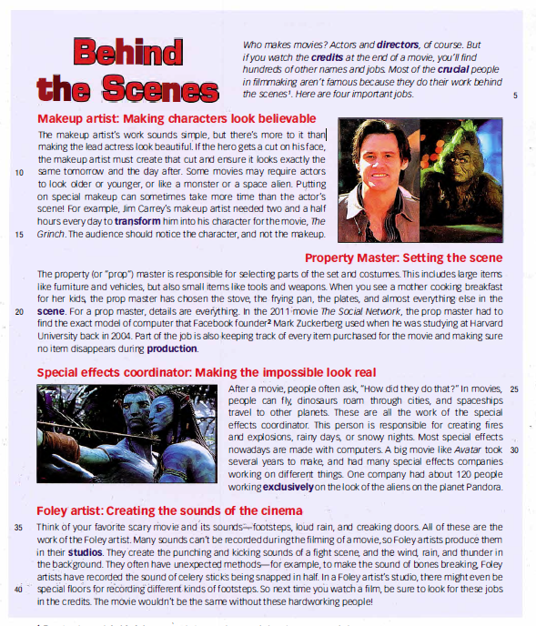

Slide 6
A. Look at the title and subheadings of the passage on the next page.
Then circle the correct word or phrase in each of the main ideas below.
1. Makeup artists help the actors and actresses (sound great / look different).
2. The prop master gets (objects / money) needed for the movie.
3. The special effects coordinator creates things that (are / are not) real.
4. Foley artists work with the things you (hear / see) in a movie.

Slide 7
B. Now read the entire passage to see if your answers in A were correct.
1. Makeup artists help the actors and actresses ( sound great / look different).
Line 6: Makeup artist: Making characters look believable
The makeup artist's work sounds simple…….lead actress look beautiful.
2. The prop master gets ( objects / money ) needed for the movie.
Line 16-17-18: Property Master: Setting the scene
The property (or "prop") master ....... small items like tools and weapons.
3. The special effects coordinator creates things that ( are / are not) real.
Line 24 & 27: Special effects coordinator: Making the impossible look real
These are all the work of the special effects coordinator.
4. Foley artists work with the things you ( hear / see) in a movie.
Line 34-35-36: Foley artist: creating the sounds of Jhe cinema
Think of your favOrite scary movie and its sounds - footsteps, loud rain, and creaking doors. All of these are the work of the Foley artist.

Slide 8
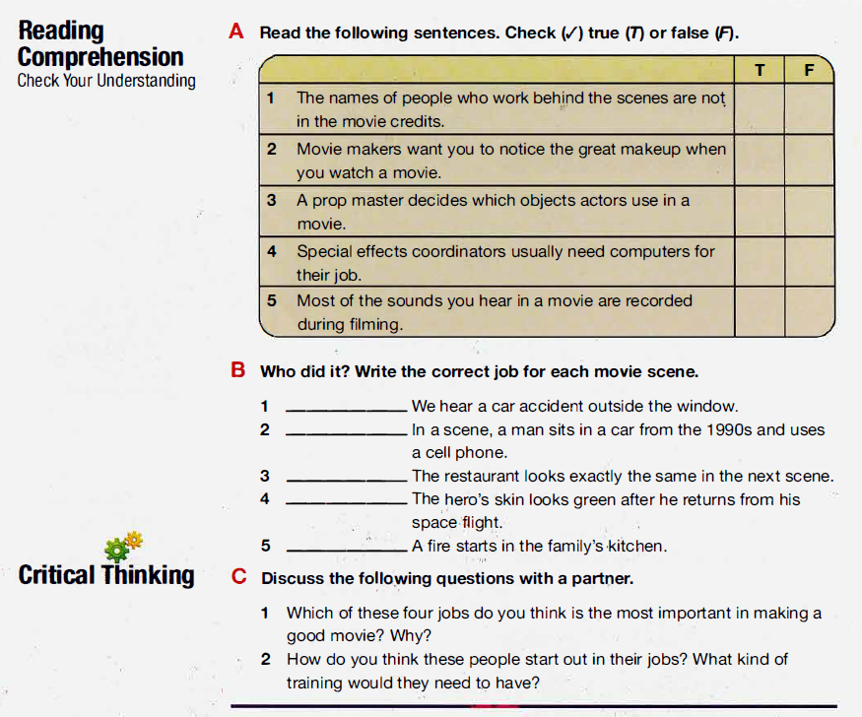
C. Read the passage again carefully. Then answer the questions on page 34.

