Slide 1
UNIT 9:
CITIES OF THE WORLD
6th grade
LESSON 7: LOOKING BACK

Slide 2
VOCABULARY
capital, tower, river bank, palace, floating market, stall, ancient, theater, market, sea, lake, beach, bank, temple, hotel, gas station, hair salon, library, police station, hospital, movie theater, park, zoo, square, art gallery, airport, school, café, etc.
CITIES AND LANDMARKS:

Slide 3
PRONUNCIATION
/əʊ/ | /aʊ/
No, go, ago, slow, snow, soap, coast, load, shoulder, poultry, window
Mouth, shout, down, around, country, sound, power, crown

Slide 4
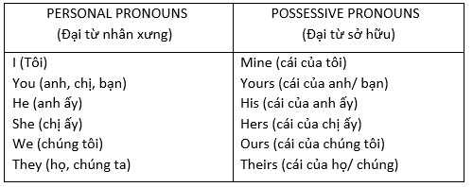
GRAMMAR: Possessive pronouns
Là hình thức sở hữu của đại từ nhân xưng (personal pronouns), được dùng để chỉ vật gì thuộc về người nào đó.
Đại từ sở hữu được dùng không có danh từ theo sau. Nó thay thế cho tính từ sở hữu + danh từ (possessive adjective + noun)
Ex: This pen is mine. (Chiếc bút là của tôi)

Slide 5
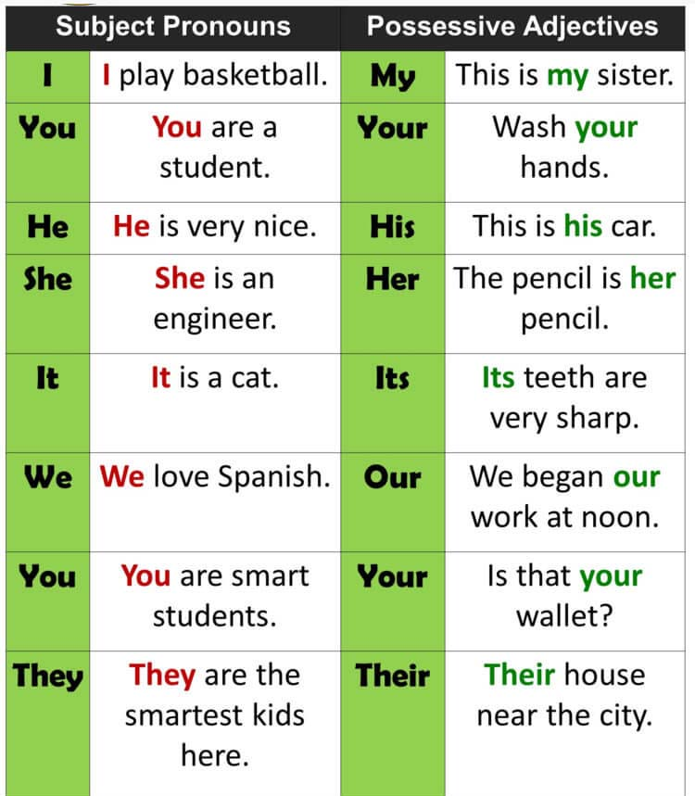
GRAMMAR: Possessive adjectives
Tính từ sở hữu là một từ đứng trước danh từ, có chức năng chỉ rõ danh từ đó thuộc quyền sở hữu của ai/ cái gì. Nó có nhiệm vụ bổ nghĩa cho danh từ
Cấu trúc: Tính từ sở hữu + Danh từ

Slide 6
Choose the best two options to complete the sentences.
1. The city is .................
A. exciting B. amazing C. long
2. The weather is ..................
A. cold B. quiet C. sunny
3. The people are .................
A. friendly B. wide C. helpful
4. The buildings are ..............
A. tall B. beautiful C. fast
5. The food is ......................
A. cute B. delicious C. good
thú vị
tuyệt vời
dài
lạnh
yên tĩnh
nắng
thân thiện
rộng rãi
hữu ích
cao
đẹp
nhanh
dễ thương
ngon
tốt

Slide 7
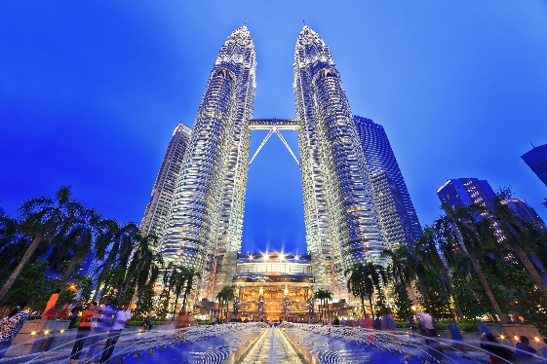


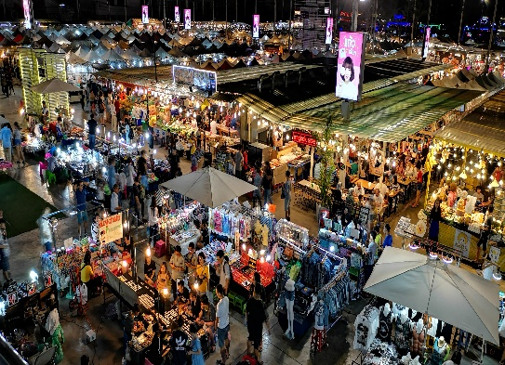
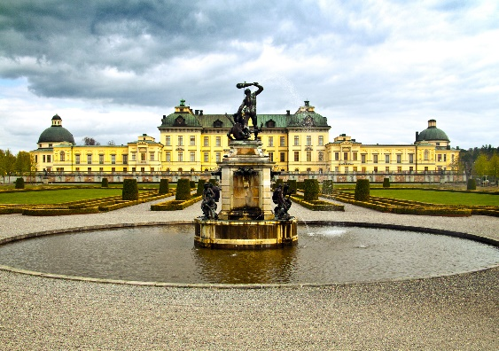

Write the words in the box under their pictures.
towers
beach
river bank
postcard
palace
night market
1.
towers
2.
river bank
3.
beach
4.
night market
5.
palace
6.
postcard

Slide 8
Complete the sentences with the correct possessive pronouns in the box.
theirs
hers
yours
mine
ours
1.
yours
Hey Phong. You’re wearing my hat. It’s not .
A possessive pronoun is used alone, without a noun following it.
2.
We’re looking for Mr and Mrs Smith’s house. Is that ?
theirs
Example:
3.
This is my drawing. It’s .
mine
This book is my book, not your book.
4.
Ours
This is your room. is next door. So call us if you need anything.
This book is mine, not yours.
5.
Sue doesn’t need to borrow my pen. She’s got .
hers

Slide 9
Read the sentences and correct the underlined words.
A possessive adjective is used only when there’s a noun following it.
Example:
1.
Bangkok is an exciting city. I love it’s people
I have a pen.
its
2.
We are watching the sunrise at Angkor Wat with ours local friends.
This is my pen.
our
A possessive pronoun is used alone, without a noun following it.
3.
Discover Beijing and Shanghai through theirs food tours.
their
4.
Visit Hue and try your food.
Example:
its
This book is my book, not your book.
5.
Venice is your city and Jakarta is our.
ours
This book is mine, not yours.

Slide 10
THANK YOU!

