Slide 1

WELCOME TO
Class 7A1

Slide 2

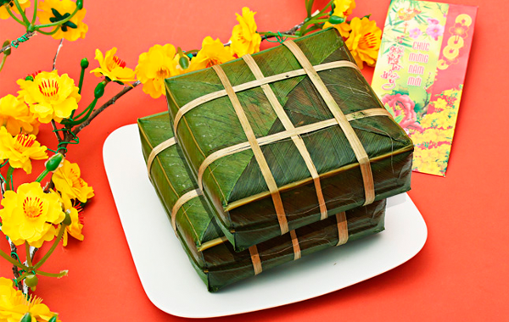
Guessing game
1. Everyone wants to return his/her hometown on this occasion.
2. It’s the most important festival in our country.
3. Children get lucky money on this occasion.

Slide 3
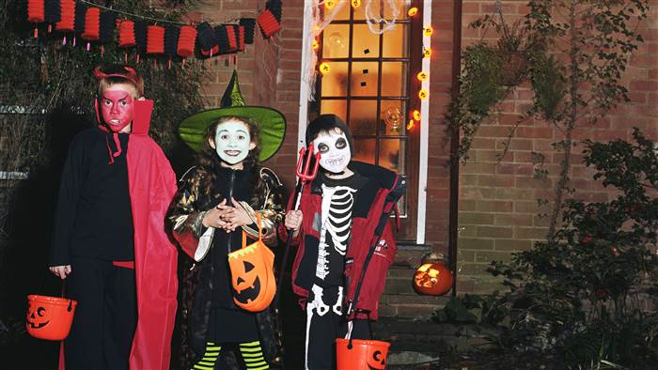
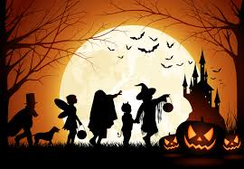
Guessing game
1. It mainly happens in America and Western countries.
2. This festival is superstitious.
3. Children knock their neighbors’ doors and say “trick or treat”.

Slide 4
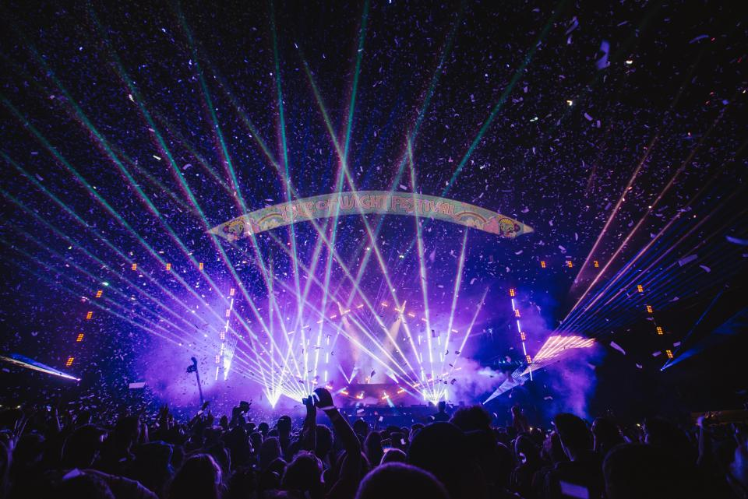
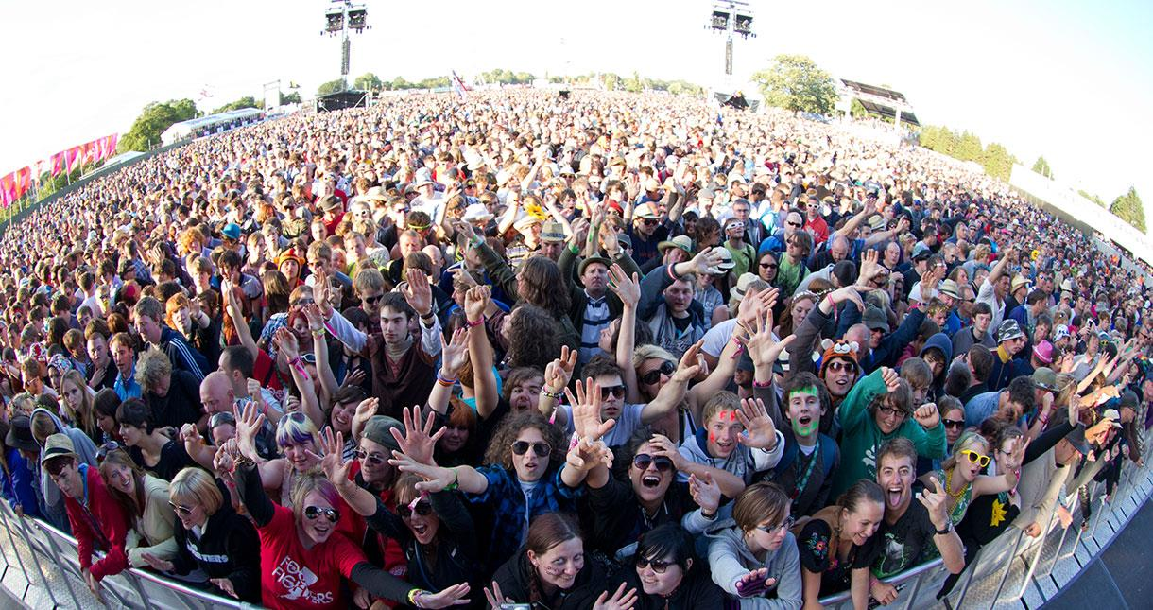
Guessing game
1. A huge number of people take part in this festival.
2. It takes place in every June in the United Kingdom .
3. It’s the most famous music festival in this country.

Slide 5


Listening
TRUE
FALSE
1. The Isle of Wight is the most well-known festival in the world.
It is one of the most famous festival in our country.
2. About 60,000 people attend the festival last year.
3. Nick and his family stay at a hotel near the campsite.
They stayed in a tent.
4. Jon Bon Jovi is Nick’s favourite singer.
He’s Nick’s dad’s favourite singer
5. Jon Bon Jovi’s band performed for nearly three hours.
Notes:
Cô bấm 1 lần hiện ra các câu hỏi. Sau đó cô bấm vào câu nào nó sẽ ra True hoặc False câu đó, bấm thêm 1 lần vào câu hỏi sẽ ra cách sửa cho câu ấy

Slide 6
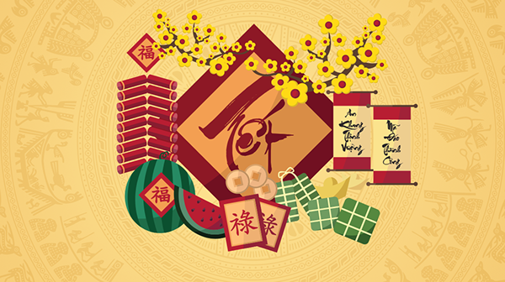
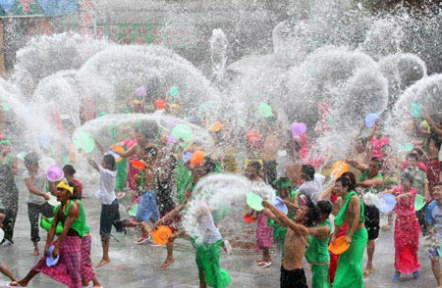
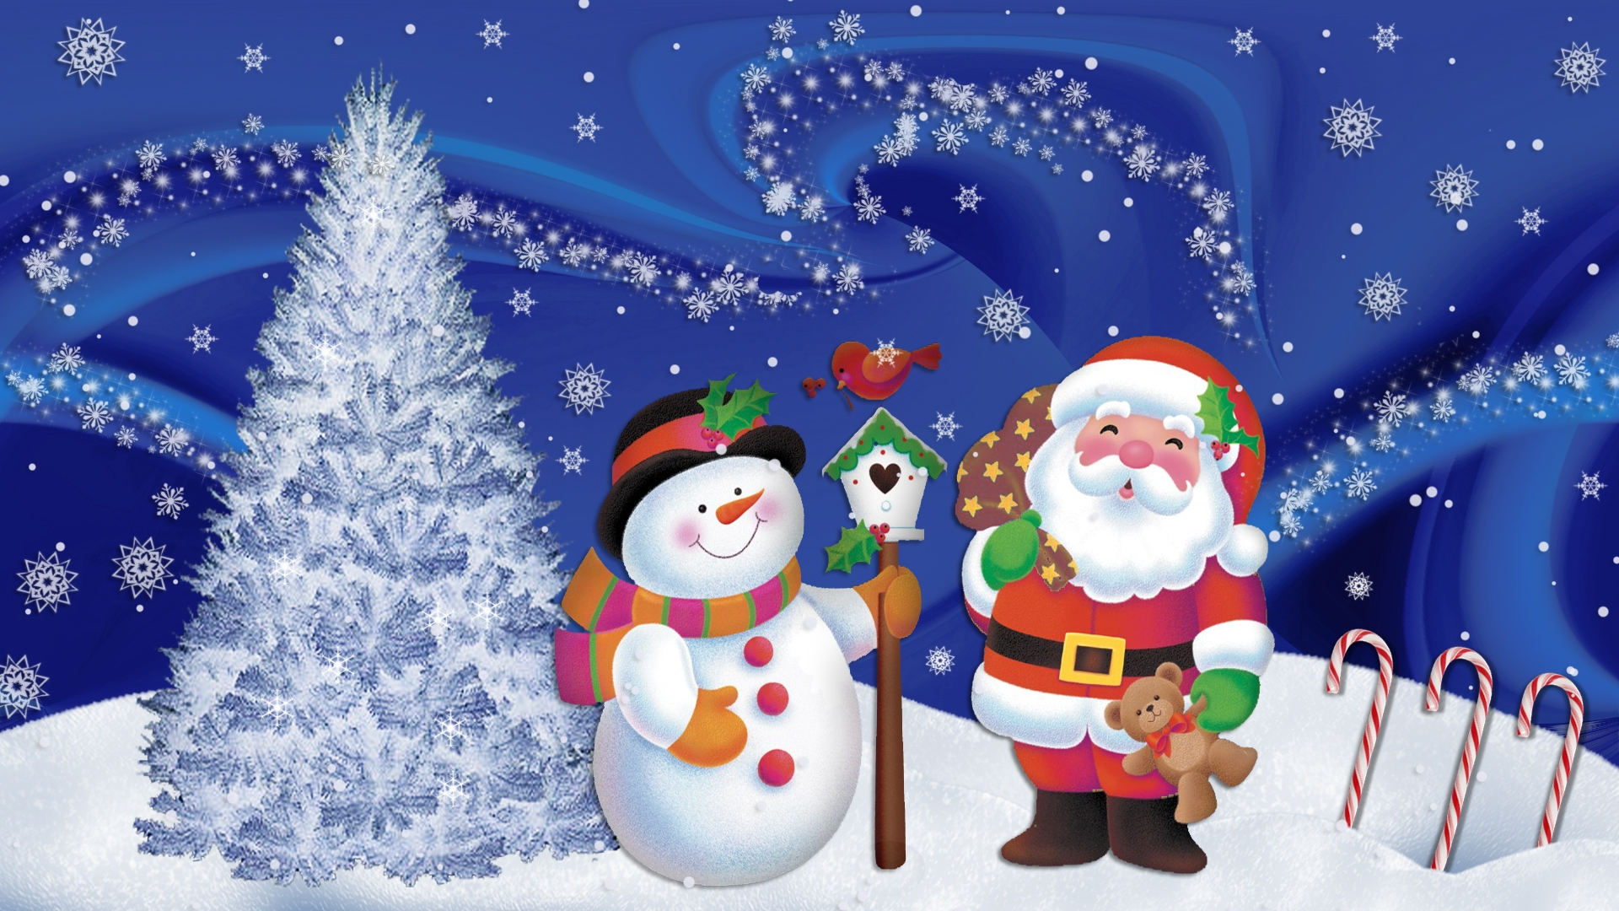
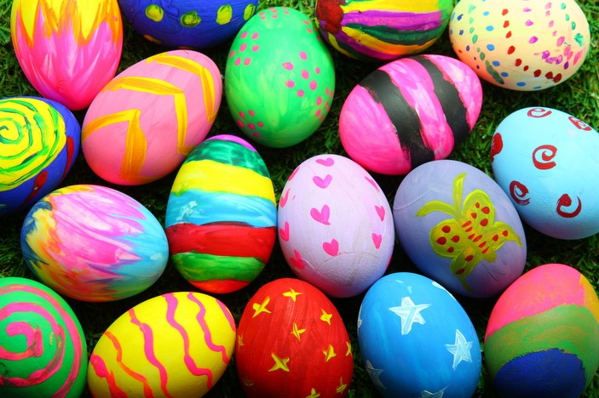
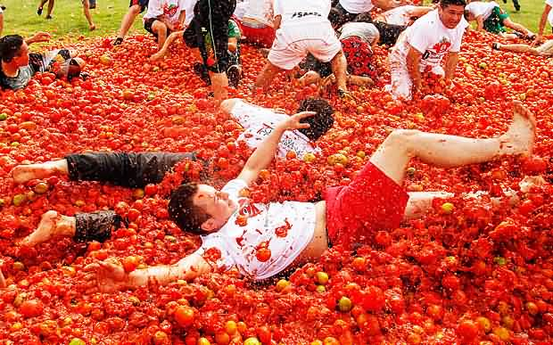
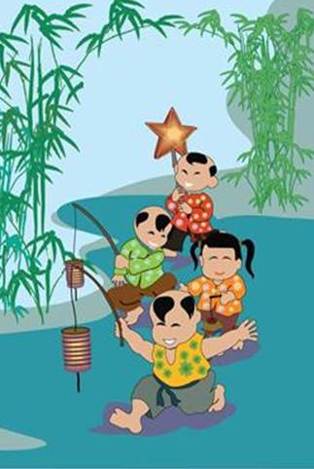
LUCKY NUMBER
Notes:
Cô bấm mũi tên để đến phần writing

Slide 7

LUCKY STAR
Notes:
Cô bấm nút hình tam giác để quay lại trò chơi

Slide 8
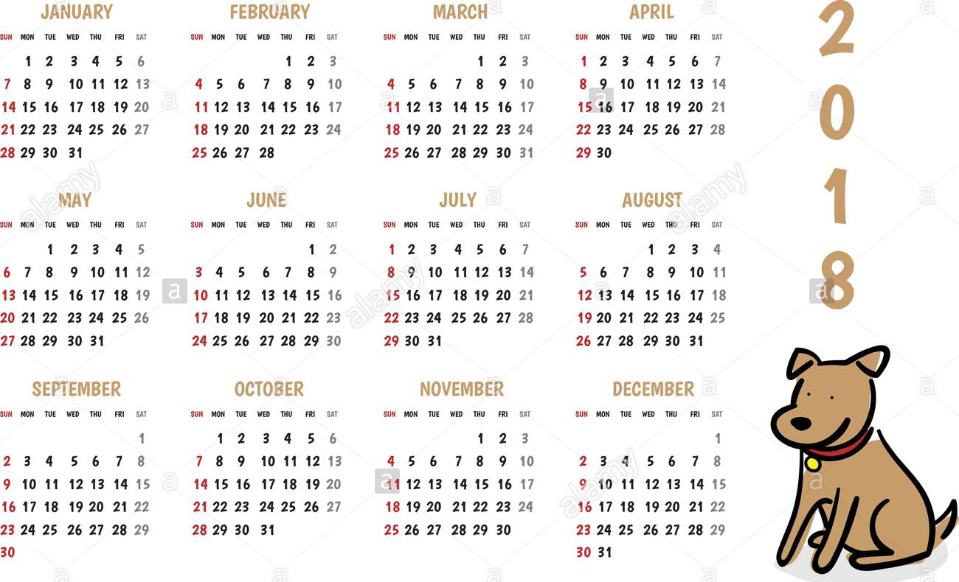
QUESTION 1:
When does the festival take place?
It takes place every June

Slide 9
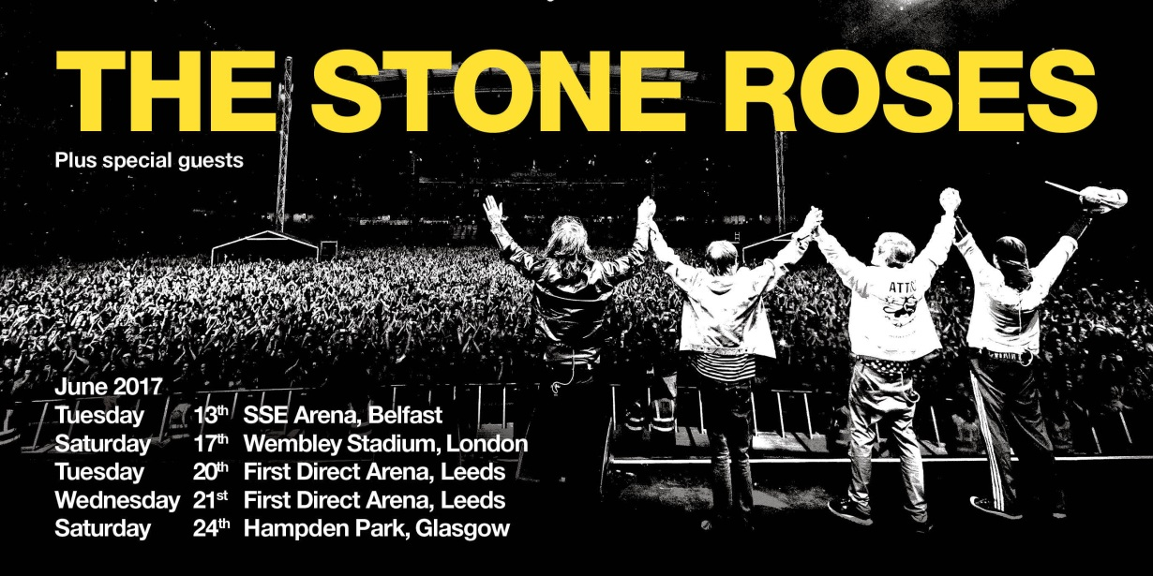
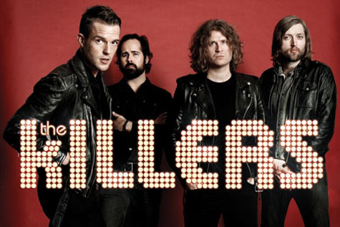
QUESTION 2:
What are The Killers and Stone Roses?
They are music bands.

Slide 10
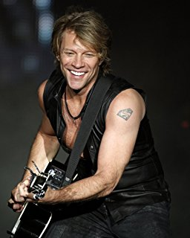
QUESTION 3:
How did Jon Bon Jovi interest the audience?
He interested the audience with the hit songs.

Slide 11
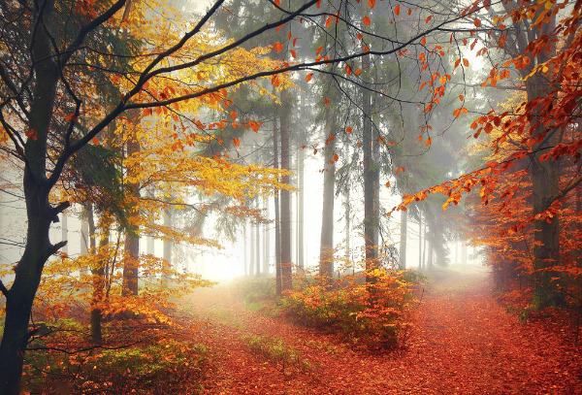
QUESTION 4:
Where did Nick and his family also go?
They also went to the Bohemian Woods.

Slide 12
QUESTION 5:
What did they do there?
They enjoyed a mix of good music from around the world.

Slide 13
WRITING
Write a short paragraph about the festival you attended
Suggestions
I. opening
Name of the festival
When and where did it take place?
II. body
How did people celebrate it?
Why did they celebrate it?
What did people do in the festival?
III. ending
Your feelings about it.

Slide 14
Festivals
Water festival
Christmas
Halloween
Mid Autumn festival
Tet
La Tomatina
Notes:
Phần này cô bấm chuột 1 lần sẽ hiện ra các tranh, bấm thêm 1 lần nữa các bức tranh xoay tròn

Slide 15


